Slide 1
IWITOT 2022
Caitlin McLoughlin

Slide 2
Hello!
Notes:
Who here is concerned about the environment?
Who here loves a good bargain?
Who here is wearing an item of second hand clothing today?

Slide 3
The Big Clear Out
Sell old belongings
Donate to British Youth Council
Notes:
We empower young people aged 25 and under to influence and inform the decisions that affect their lives. We support young people to get involved in their communities and democracy locally, nationally and internationally, making a difference as volunteers, campaigners, decision-makers and leaders.

Slide 4
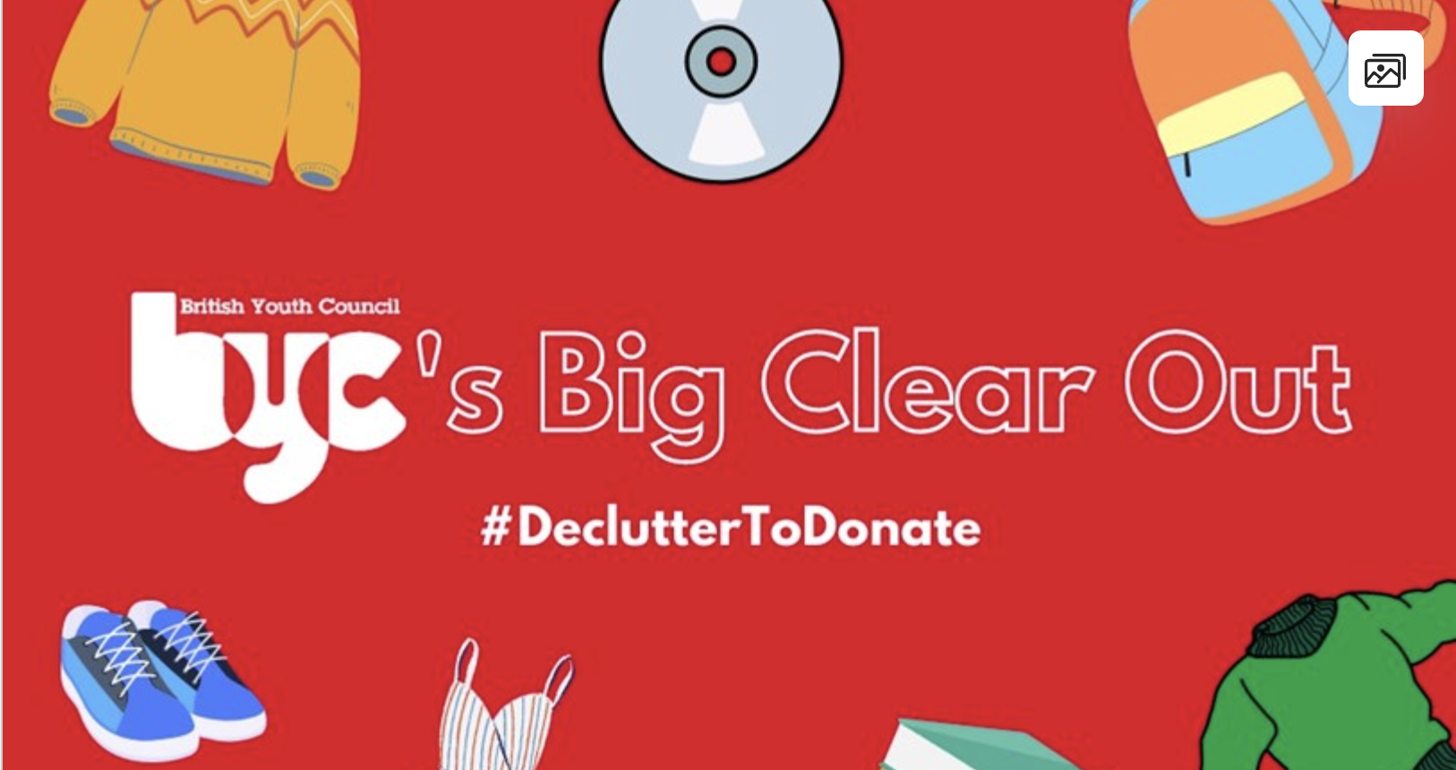
Declutter to Donate
Notes:
Clothes swap party, car boot sale, or sell through online platform
Donate proceeds to the BYC justigiving page
£154 from 6 supporters

Slide 5
The Three-Pronged Impact
Money
People
Planet
Notes:
Financially, the first time they’ve tried it and the impact was modest, but an exciting potential for three-pronged impact
Money: Fundraising & awareness
Planet: Sustainability
People: Cost of living access to cheaper goods, and chance to clear out

Slide 6
Why It’s a Winning Idea
Low Effort, High Reward
Fresh Ask
Triple Impact!
Covid Recovery World
Notes:
Low effort: don’t need lots of volunteers and resource for a charity shop, ‘charity shop’ alternative Fresh ask & calls to action: asking people running the sales to support young people, support the environment and clear our their house. Asking people not to donate but to purchase – they are very clearly getting something material out of their purchase Covid Recovery World: People could sell online and in person – many ways to host a clothing sale Triple impact: Young People: increasingle interested, interesting way to encourage them to get involved and support your org

Slide 7
What We Should Take Away
Impact
Campaigns can be impactful in many ways
Effort
We don't have to do it all by ourselves!
Experimentation
Would you try something similar?

