Slide 1
I Wish I’d Thought of That!
Claire McMinn

Slide 3
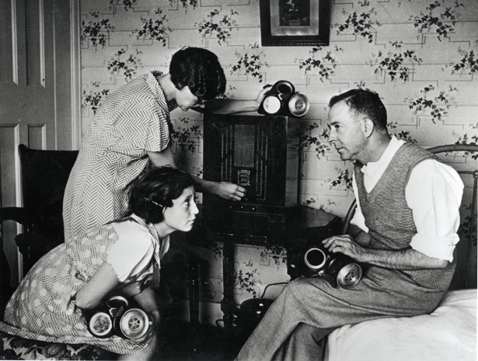

Slide 4
What makes BBC Radio 4 appeals so great?

Slide 5
Some Faces behind the appeals…
Vee Kativhu
Angelica Bell
KT Tunstall
ian McEwan
United World Schools
Innovations for Learning
Hope & Homes for Children
Solar Aid
Annie Lennox
Sophie Morgan
Richard Hammond
Nadiya hussain
Shelter
Leonard Cheshire
Primary Trauma Care Foundation
IMPACT

Slide 6
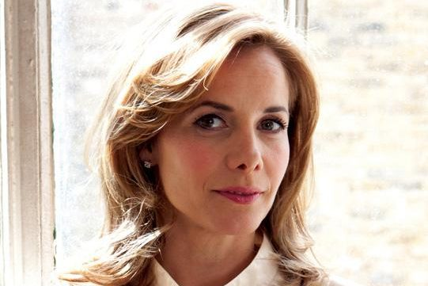

Slide 7
If the story is not about the hearer, he will not listen.
“
”
John Steinbeck in East of Eden

Slide 9
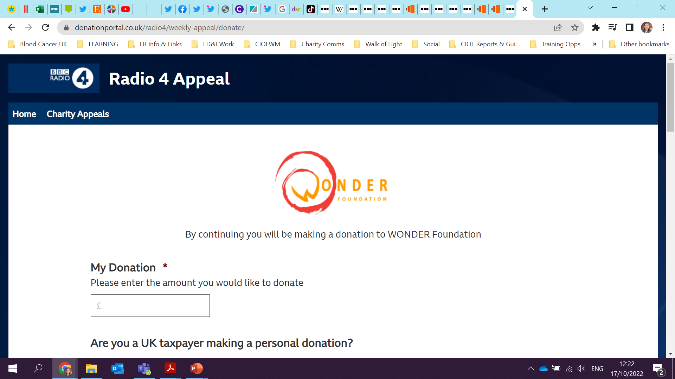

Slide 10
Let’s chat figures

Slide 11
If you ever feel like there is no one there… turn on the radio.
“
”
Scott Mills,

Slide 12
THANK YOU

