Slide 1
Do your holiday photos (sometimes) look like this?

Slide 2
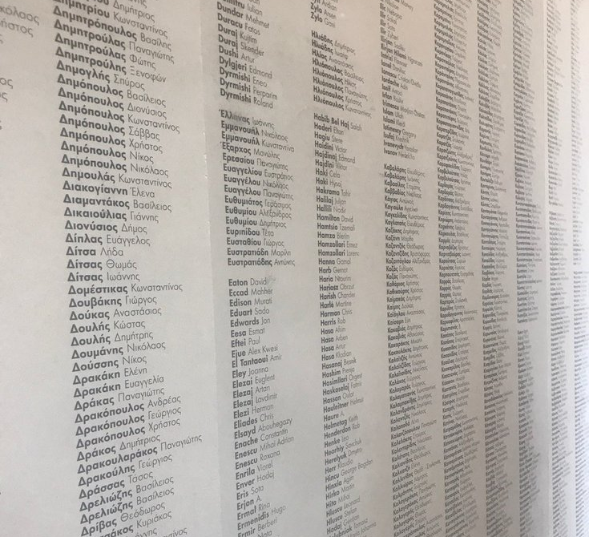
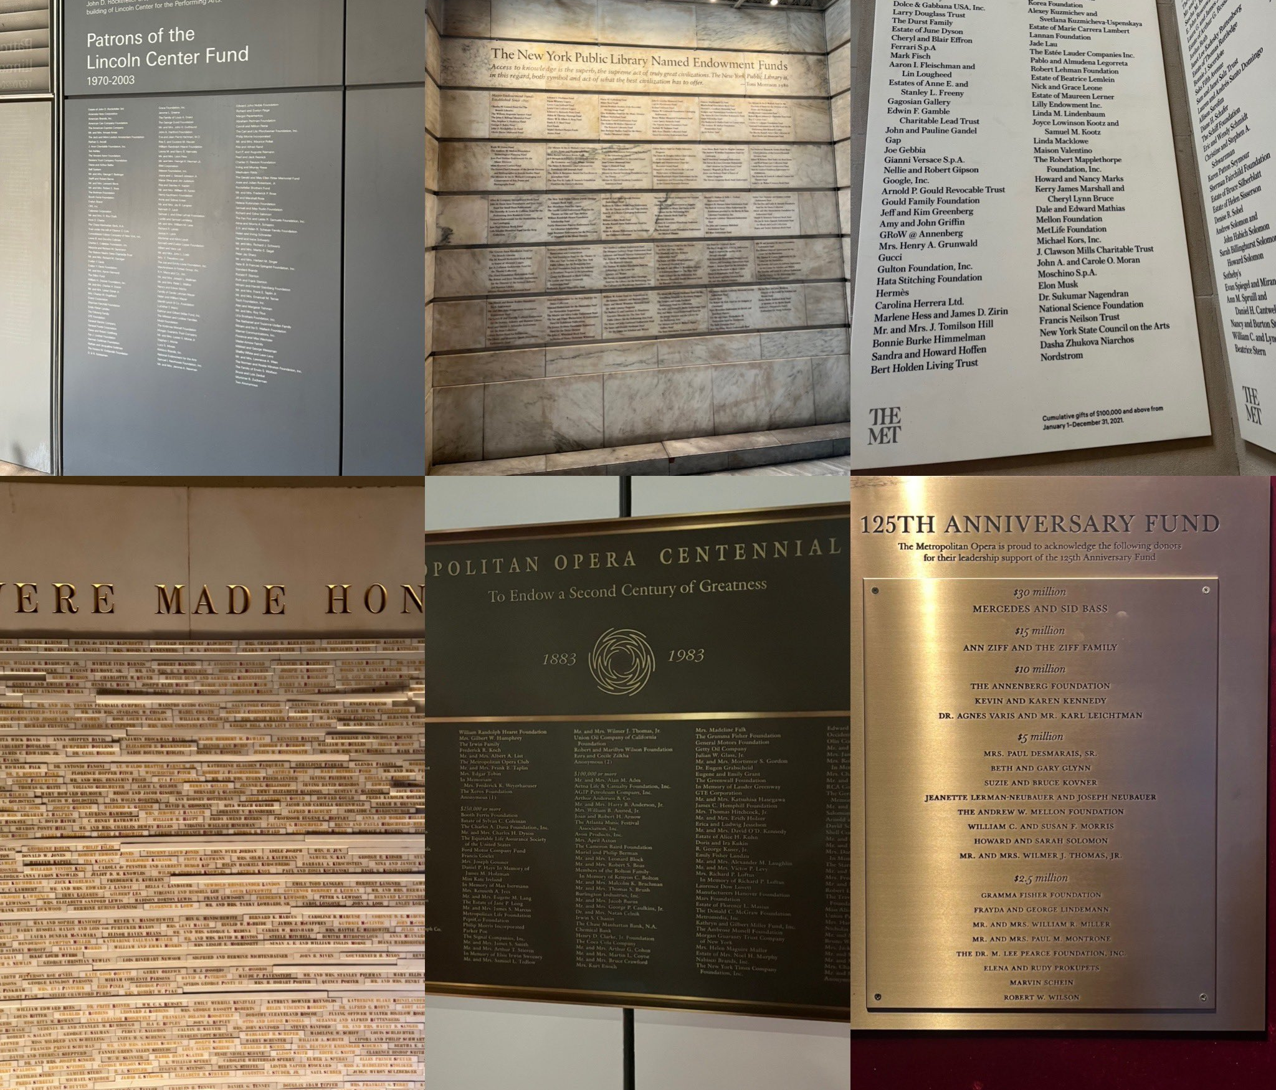
Fundraiser on holiday
Notes:
It screams fundraiser on holiday
Yes I’m talking about donor walls and recognition … from the dull

Slide 3
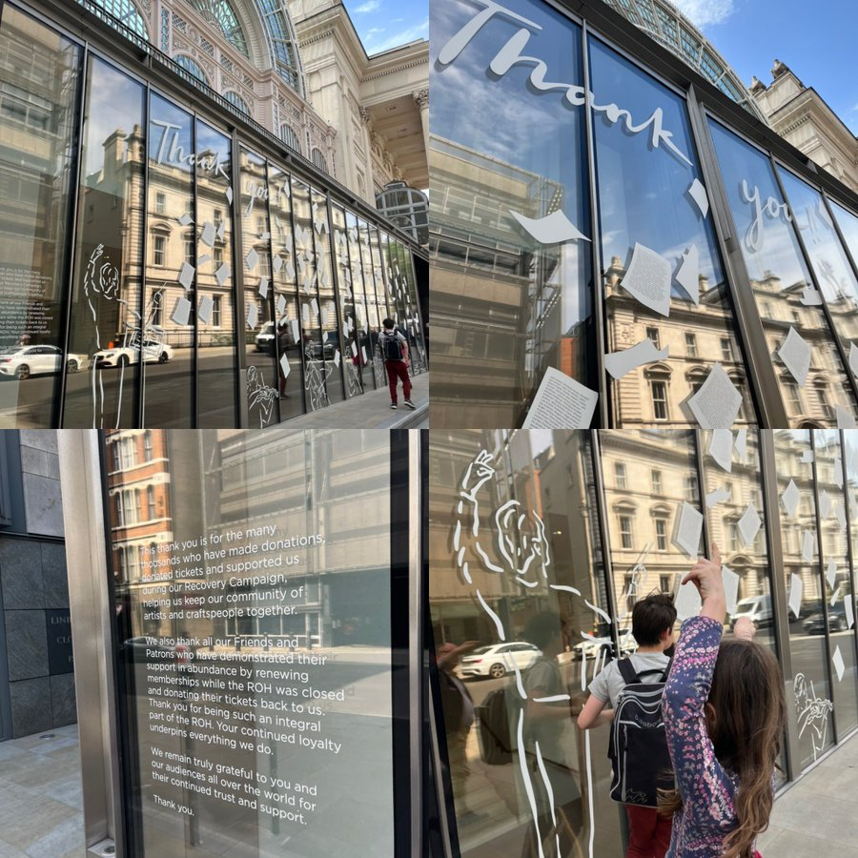
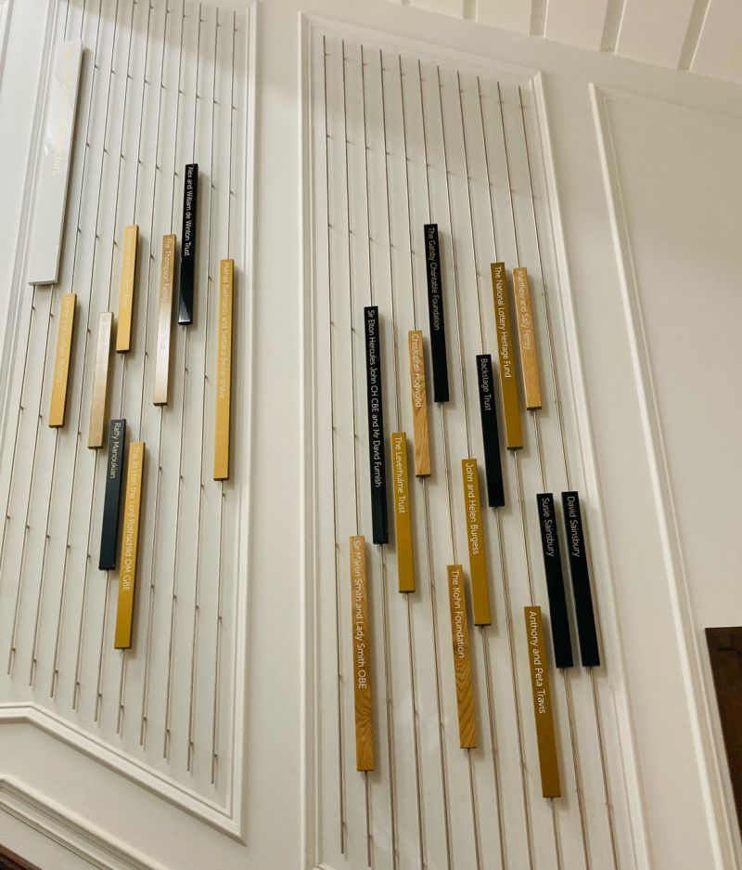
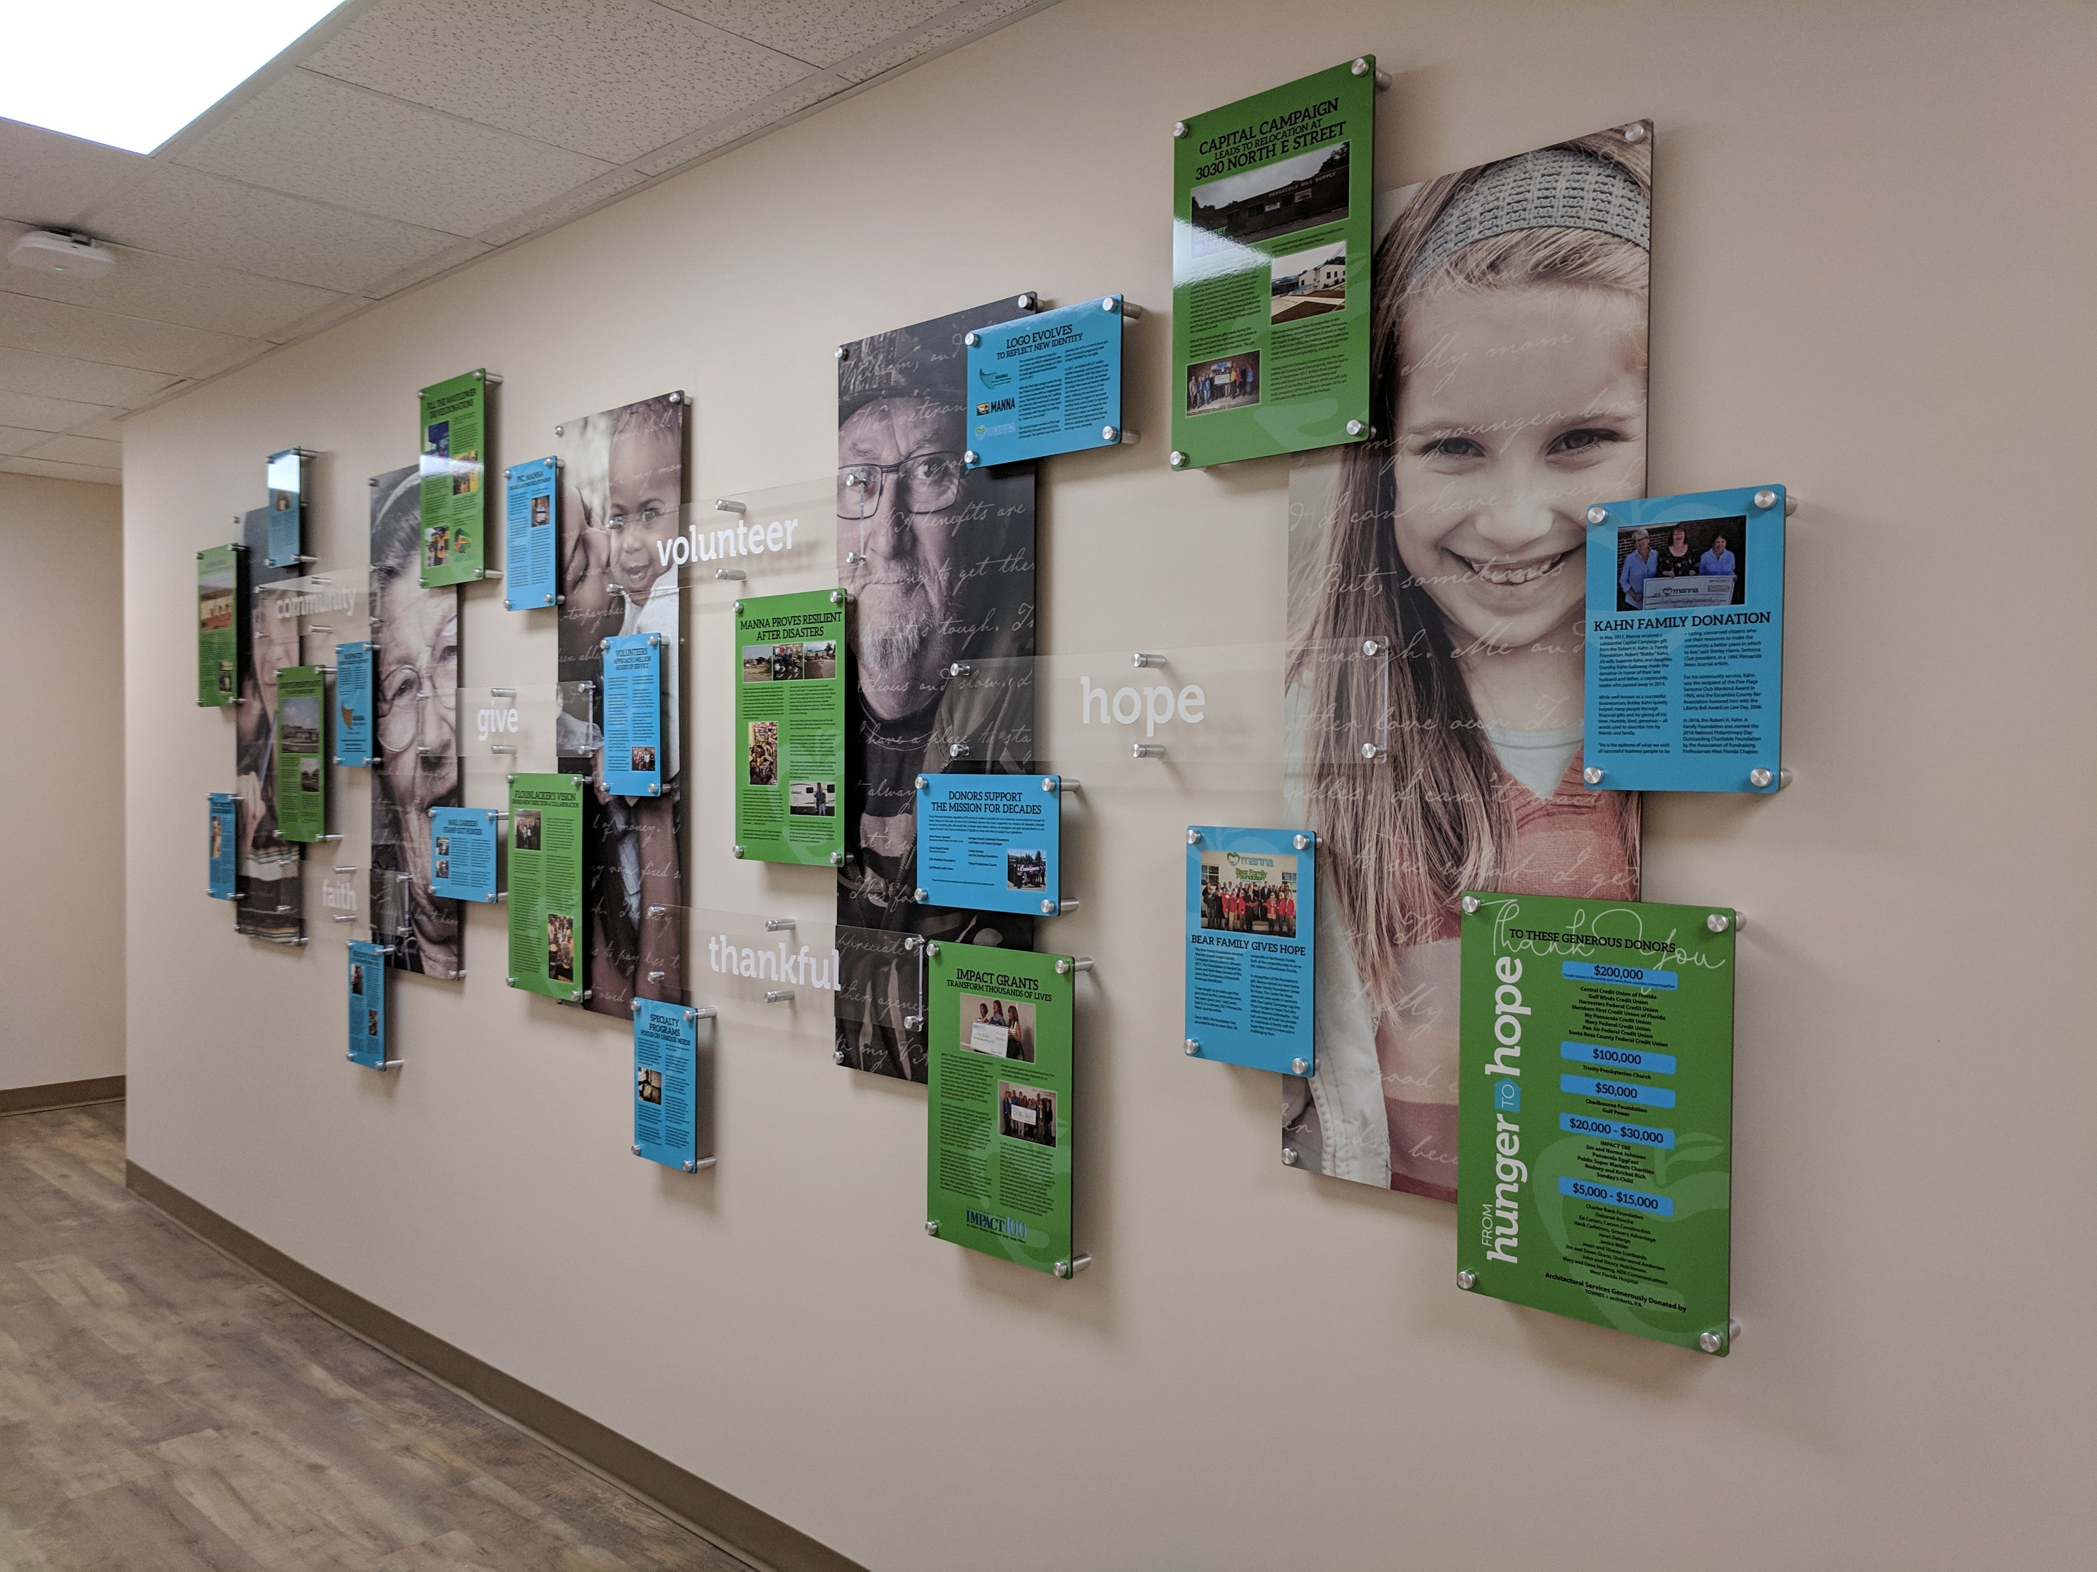
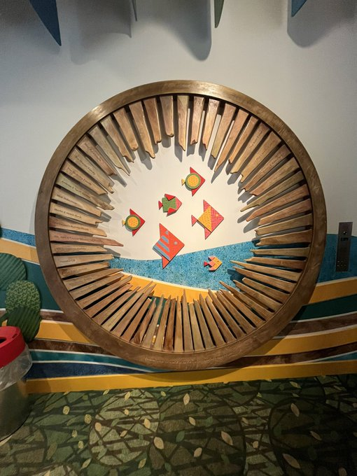
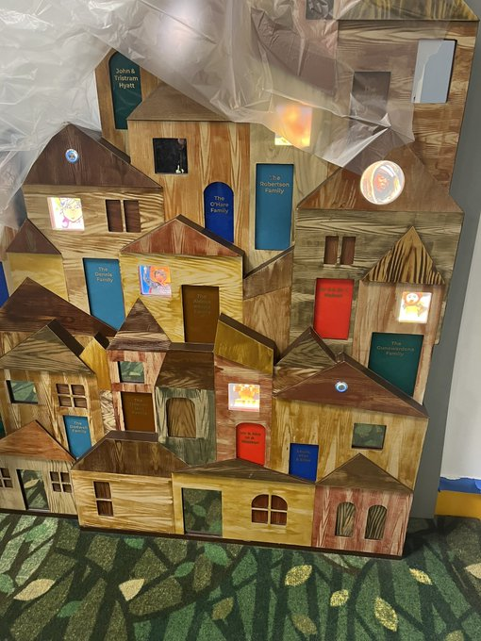
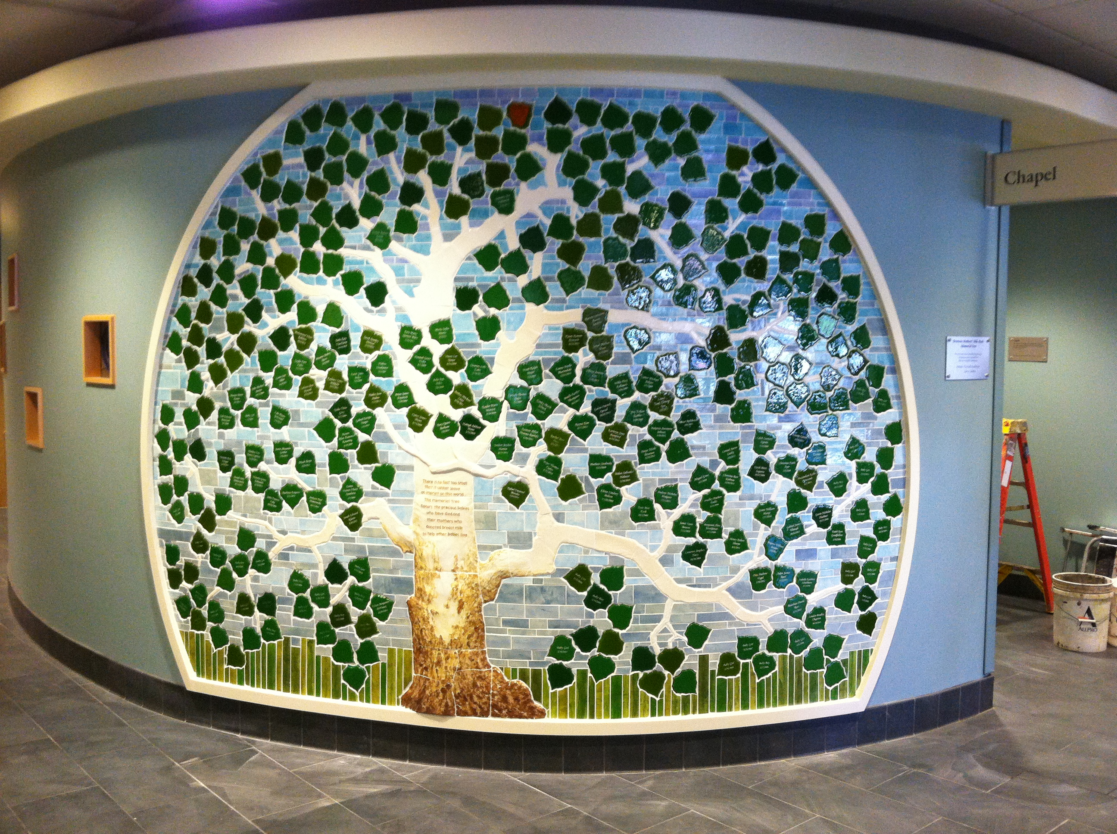
Notes:
To the more interesting

Slide 4
Notes:
To pretty

Slide 5
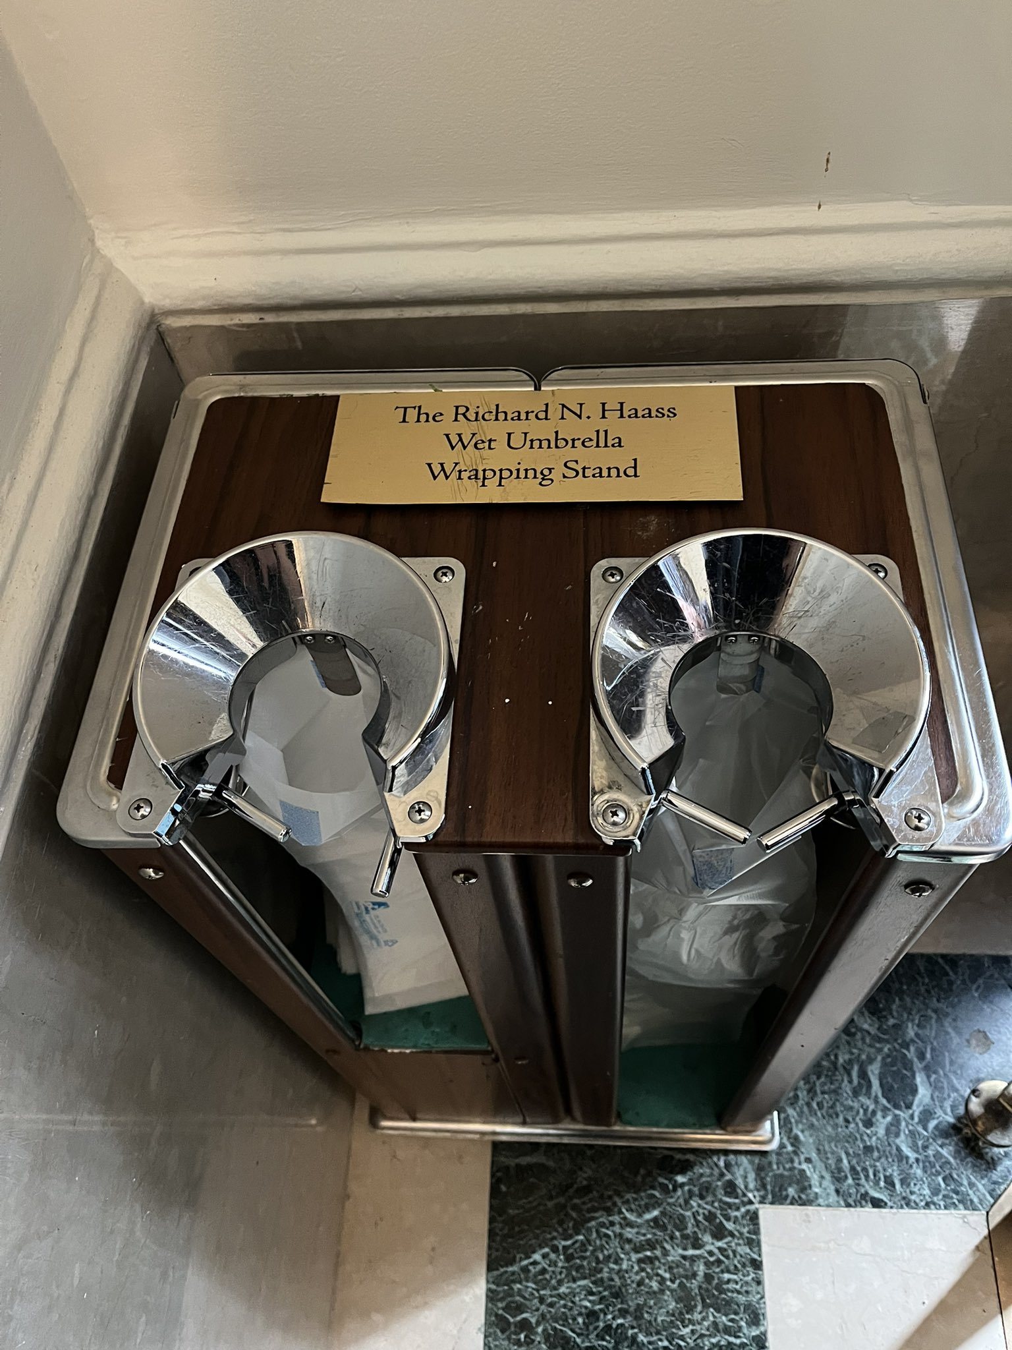
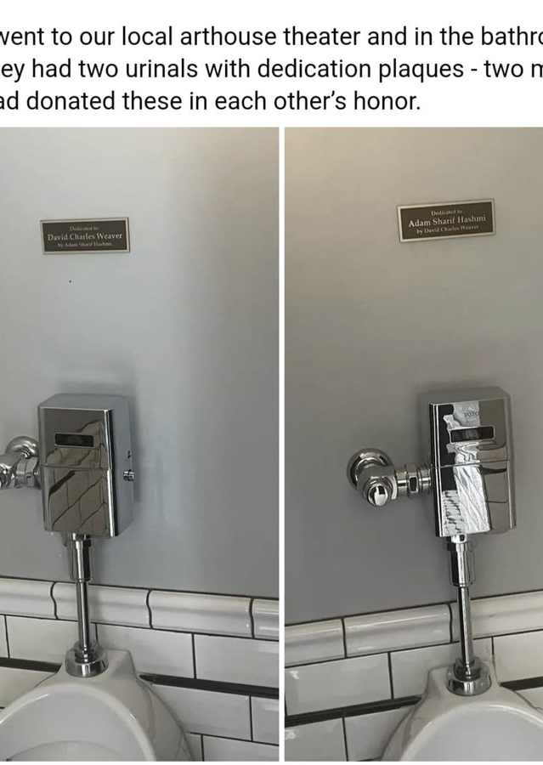
Notes:
Or quirky (this is a donor credit on an umbrella stand and a urinal!)

Slide 6
Then I bet you wish you thought of
Notes:
Then I bet like you me you wish you thought of donor recognition

Slide 7
Donor recognition
Notes:
Then I bet like you me you wish you thought of donor recognition

Slide 8
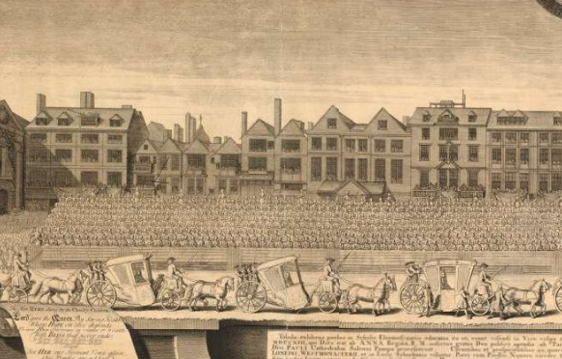
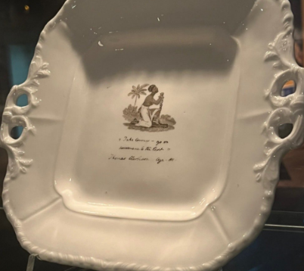
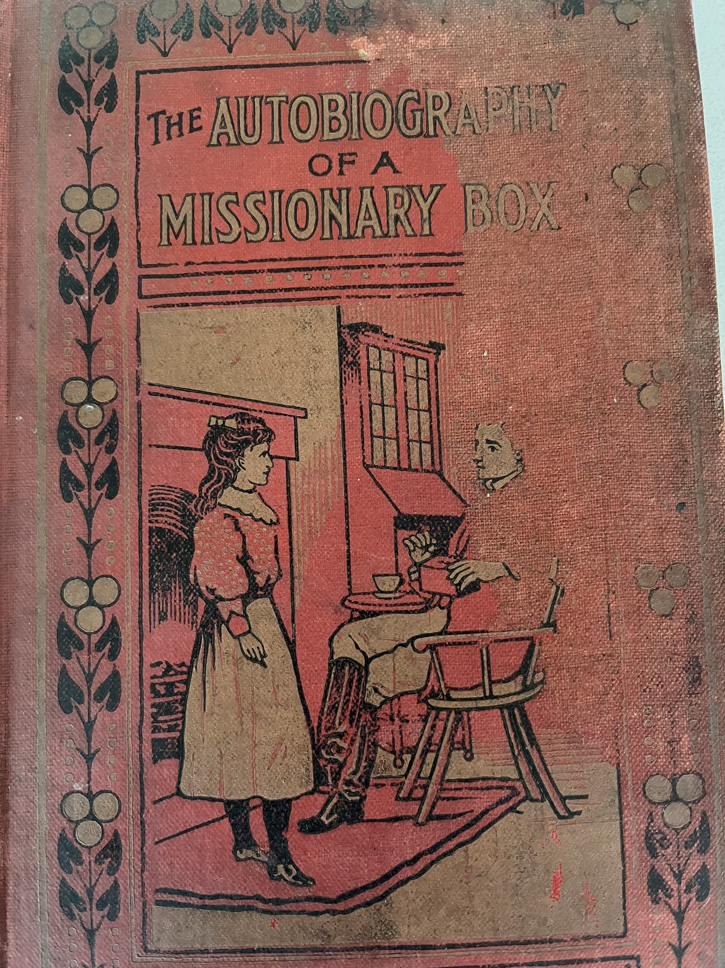
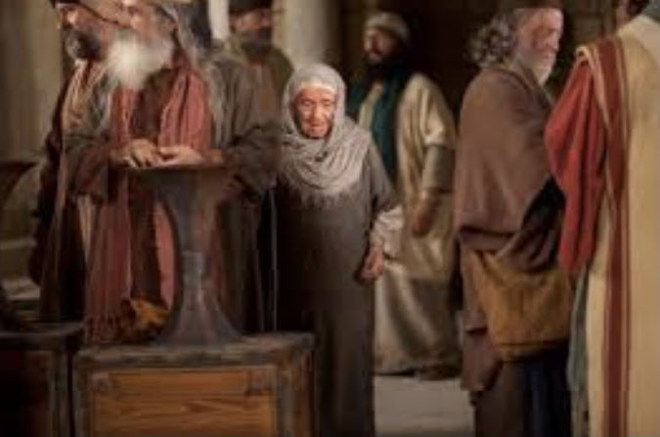
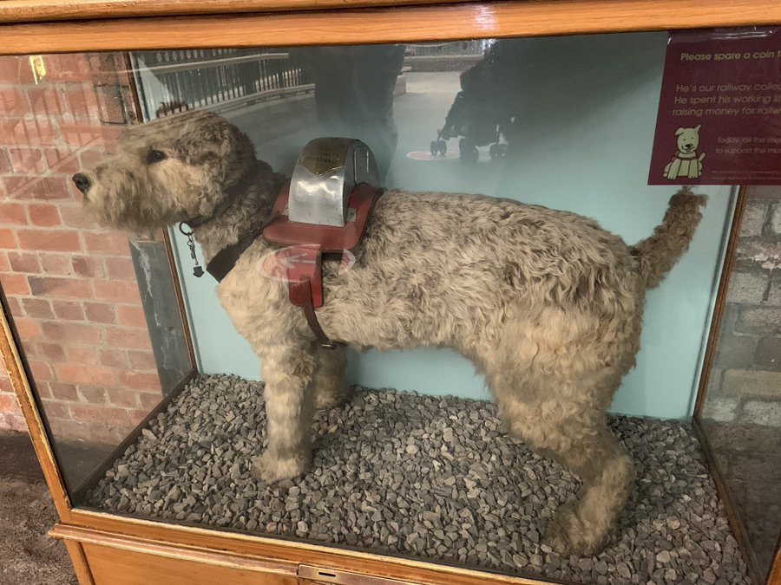
History of fundraising

Slide 9
The earliest donor acknowledgment?
Notes:
Arts philanthropy donor acknowledgment 313BC - Greek style - for the choregoi (Auteus and Philoxenidies) who funded the chorus (costumes & rehearsals) the second most expensive lot that wealthy Athenian could get allocated to use their wealth for the public good

Slide 10
So let me tell you about Nigel, Joan and Robert …

Slide 11
Nigel
Notes:
Now Nigel was a fourteenth century miller
Every year he gave 4 shillings to the St Albans Abbey
You can see him here giving his gift

Slide 12
Joan
Notes:
Joan, countess of Kent, and princess of Wales and of Aquitaine (d. 1385), who gave a gold necklace and 100 shillings:

Slide 13
Robert
Notes:
Robert Chamberleyn, squire of the king, who gave wine liberally (1417): Cotton MS Nero D VII, f. 142v
Gifts in kind matter too

Slide 14
St Albans Benefactors Book
Notes:
And why do we know about Nigel, Robert and Joan and others
These all come from The Benefactors' Book begun around 1380 as a register of members of the St Albans Abbey's confraternity
According to the preface, anyone who made a donation could be admitted into the confraternity, which granted them a lavish induction ceremony, spiritual benefits and a record in this prestigious book.
Æthelgifu, a 10th-century noblewoman who gave lands, 30 gold mancuses, 30 oxen, 20 cows, 250 sheep, a herd of pigs with a swineherd, 2 silver cups, 2 horns, a book, a curtain and a cushion:
Gifts of all sizes are recorded – and yes a gift hierarchy is still in place – with the biggest gifts and the titled people first – but the fact that Nigel’s four shillings is recorded and each donor gets their illuminated portrait celebrates ALL gifts and donors

Slide 15
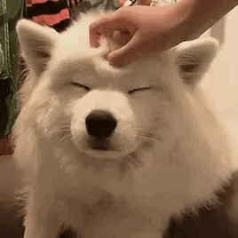
Why does it work ….
People engage in more prosocial behaviours like giving to charity when they are recognised & rewarded for the behaviour
So donor recognition as an incentive works (even if it is your name on a list)
Seeing your name on the wall gives you a hit of happy chemicals
It is like the ultimate ego stroke
Donor recognition provides a social reinforcement of their identity – as a kind and generous person
The larger the gift the more public recognition needed
Notes:
People engage in more prosocial behaviours like giving to charity when they are recognised & rewarded for the behaviour
So donor recognition as an incentive works (even if it is your name on a list) - We have all had donors that just scour the donor wall to find their name
Seeing your name on the wall gives you a hit of happy chemicals
These chemicals are Dopamine, Oxytocin, Serotonin, and Endorphins. On both a biological and a mental level, the release of these chemicals makes us happy. This happiness leads us to want more happiness. These chemicals make us want more of the same chemicals.
It is like the ultimate ego stroke
We like to feel good about ourselves and we want others to view us as we view our best selves – Donor recognition provides a social reinforcement of their identity – as a kind and generous person It gives them social status and prestige

Slide 16
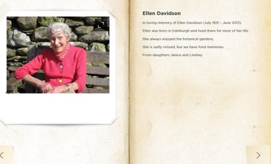
And where do we see that today

Slide 17
What can we learn from this
Celebrate your donors – big and small – every little helps and every gift is appreciated
Build relationships
Encourages others
Make it personal to them and what they gave
Future proof your donation board
Notes:
We all know we ought to recognise donors but why…
1) It shows that your organization truly cares.
Values everyone who gives
Demonstrates your commitment to those that give to your cause
HOW CAN YOU RECOGNISE GIFTS OF ALL Kinds
2) It helps strengthen relationships.
Builds loyalty
Helps with retention
Everyone feels an important part of your story —a story they want to help move forward!
And in this case you are also immortalised in an illuminated portrait – and we are talking about Robert, Joan and Nigel 700 years later – see what four shillings can do!
3) It encourages involvement from others.
Encourages support from others
When see others giving more likely to see important to get involved In the process of acknowledging those who have given to your organization, you can also encourage support from others. When people see that their friends, family members or millers are giving to a cause, they’re more likely to believe it’s important enough to get involved themselves.
4 Make it personal
5 Future Proof
Names added 11th century to 16th century and still had more room
Future proof your donor recognition!
And that is why I wish I had thought of DONOR RECOGNITION
Thank you

