Slide 1
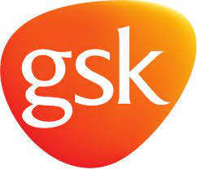

A unique partnership save the children and gsk November 2022
Notes:
Title

Slide 2
THE PARTNERSHIP – SAVE THE CHILDREN AND GSK
GSK had supported Save the Children for years.
Most gifts were small. On different projects.
2013 – formed an ambitious and strategic global partnership.
To date, they have reached 2.8 million children across 45 countries.
Relationship attracts close to £5 million a year.

Slide 3
THE PARTNERSHIP – WHY I WISH I THOUGHT OF IT
It took time to build something transformational.
Found the sweet spot for both organisations (gel with Chlorhexidine saves 400,000 newborns a year).
Ambition and scale.
Relationship went just beyond funding.
Both partners have something to gain.
Feel good story

