Slide 1
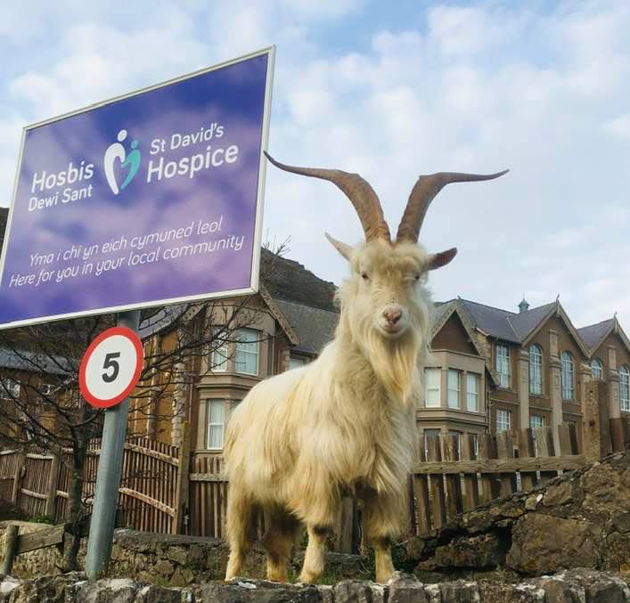
#IWITOT10
I WISH I’D THOUGHT OF…
St David’s Hospice GOAT
t-shirt fundraiser
Notes:
Hello IWITOT. I’m delighted to present the fundraising idea I wish that I’d thought of and for an opportunity to wear proper shoes whilst doing a presentation!
I hope you like goats. Because the fundraising idea I wish I had thought of was sparked by the team at my local St David’s Hospice in Llandudno, north Wales. In the early days of Covid chaos it was a herd of cheeky goats who roamed around the nearby town and made worldwide news that inspired St David’s most successful fundraising initiative to date.
The goats t-shirt fundraiser idea twice appeared on BBC breakfast, merchandise was sold as far away as in Japan and over £300k has been raised to date.
I’m not kidding.

Slide 2
Have you herd about the Llandudno goats?
Notes:
Slide 2 – Have you herd about the goats?
You might remember Boris’ briefings but I wonder if you remember the Kashmiri goats. During lockdown number 1 of 3,000 Llandudno’s residents became familiar with herds of goats feeling bold enough to visit the local town and chomp on people’s gardens. They made several trips to St David’s Hospice where they would entertain patients and staff by headbutting cars and relieving themselves in the visitors’ carpark. But the Kashmiri goats made up this disruption when their newfound fame sparked an idea.

Slide 3
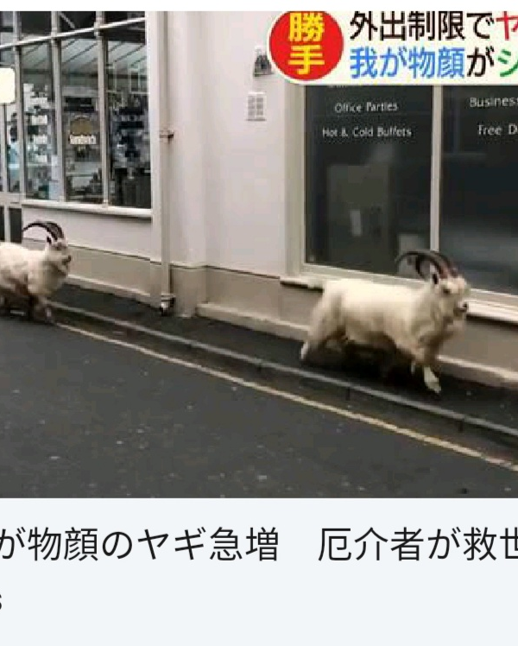
Notes:
Slide 3 – Media and idea
Like many of us, St David’s hospice had to halt fundraising operations in 2020. This meant shutting 25 hospice shops, 2 cafes, cancelling all their events and face to face fundraising as well as furloughing all but 3 members of fundraising staff. It costs £5m a year to keep the hospice and its support services running and only 9% of St David’s Hospice funding coming from the Welsh government.
With a tiny fundraising team holding the fort, balancing home schooling with social distancing, the familiar sight of the goats got one fundraiser considering how the news coverage could work in their favour. And so, inspired by the Beatles album cover* and the hospice’s location on Abbey Road in Llandudno, a goat t-shirt was born. A design was produced and an online shop was set up from someone’s kitchen table in record time The orders started rolling in, but then disaster struck.

Slide 4
things got baaa-d
Notes:
Slide 4 – An idea is born – but disaster strikes
Just as the financial situation couldn’t look any worse for St David’s, burglars raided their donation centre and caused thousands of pounds worth of damage. The fundraising team sent out a simple message on Facebook asking the local community to help. That’s when the magic happened.

Slide 5
7th April A simple post led to a flood of t-shirt orders 17th April Over 750 orders with over 1,000 t-shirts sold. By 25th April 2020, £20,000 had been raised May 2020 BBC Breakfast stint number 1= 3,000 t-shirts sold, £50,000 in a month! From this 5 mins slot £24,000 raised
Notes:
Slide 5 – ££s come rolling in
7th April That simple post led to a flood of t-shirt orders. It was all hands on deck with the skeleton staff they had left! Their much-loved Café Dewi was turned into a warehouse!
17th April (10 days after launch) the team had over 750 orders with over 1,000 t-shirts sold. By 25th April 2020, £20,000 had been raised – just through Goat Tee Shirt sales
May 2020 – BBC Breakfast stint number 1= 3,000 t-shirts sold, £50,000 in a month! From this 5 mins slot £24,000 raised, the retail website went down and staff inboxes overloaded with orders!

Slide 6
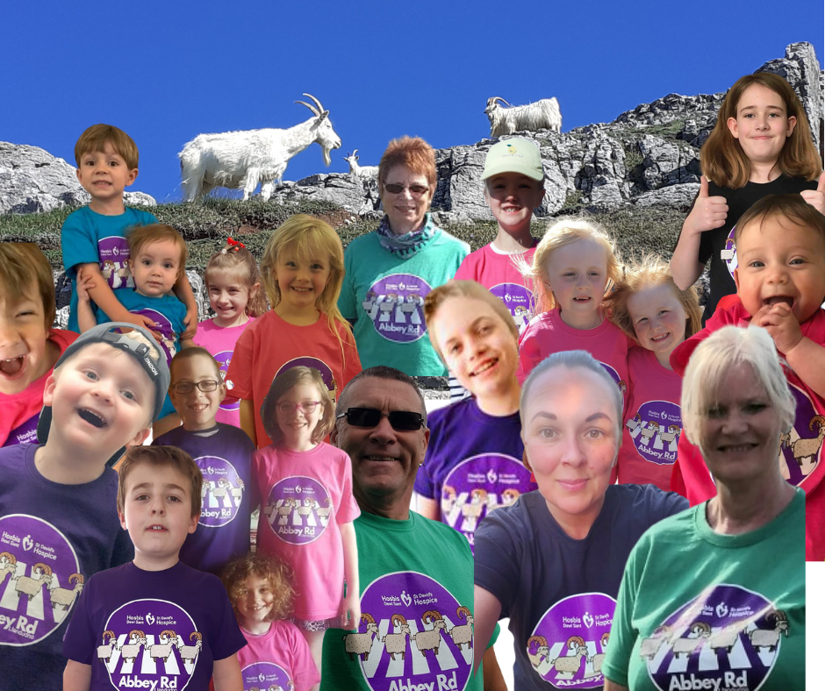
Notes:
Slide 6 Throughout the pandemic, St David’s kept their inpatient services open, ensuring people across north west Wales could receive the best possible end of life care. This insanely popular t-shirt design enabled the hospice to keep running – and sparked a whole line of goat-themed merchandise; from stuffed toys to Christmas jumpers, and ‘those bloody’ calendars. More importantly, the goat t-shirts made a profound impact on people in north West Wales.

Slide 7
“The care that Rachael and my family received was brilliant. To think they offer such excellent care and support just from donations and fundraising is amazing. They all make such a difference in the lives of people affected by terminal illness, and I can’t thank them enough for everything they did.”
- Rebecca, Rachael’s twin sister
Notes:
Slide 7 – What St David’s Hospice and the goats mean to local people like Rachael
The goat t-shirt idea meant that 22-year-old Rachael was able to live out her final days in comfort with her identical twin, Rebecca, by her side. Rachael and her family were offered complementary therapies during Rachael’s time at St David’s and her sister reflects on the care they received in the quote featured there.

Slide 8
“There will never be enough words to say how grateful we are. This charity is a lifeline to so many families and I cannot say enough how important our local hospice is and how vital it is to support them”.
- Huw’s widow, Elen
Notes:
Slide 8 The goat t-shirt idea meant that Huw Williams could spend his final days surrounded by his family and new wife, Elen when his stage 4 cancer diagnosis just two weeks after their wedding led to his rapid deterioration. Covid restrictions at the time of Huw’s diagnosis meant that Elen couldn’t have family with her at the hospital where Huw was being treated. But a transfer to St David’s Hospice during Huw’s final weeks made it possible for his whole family to be together when he passed away.
Elen is continuing to receive bereavement support from St David’s hospice and is fundraising on their behalf.

Slide 9
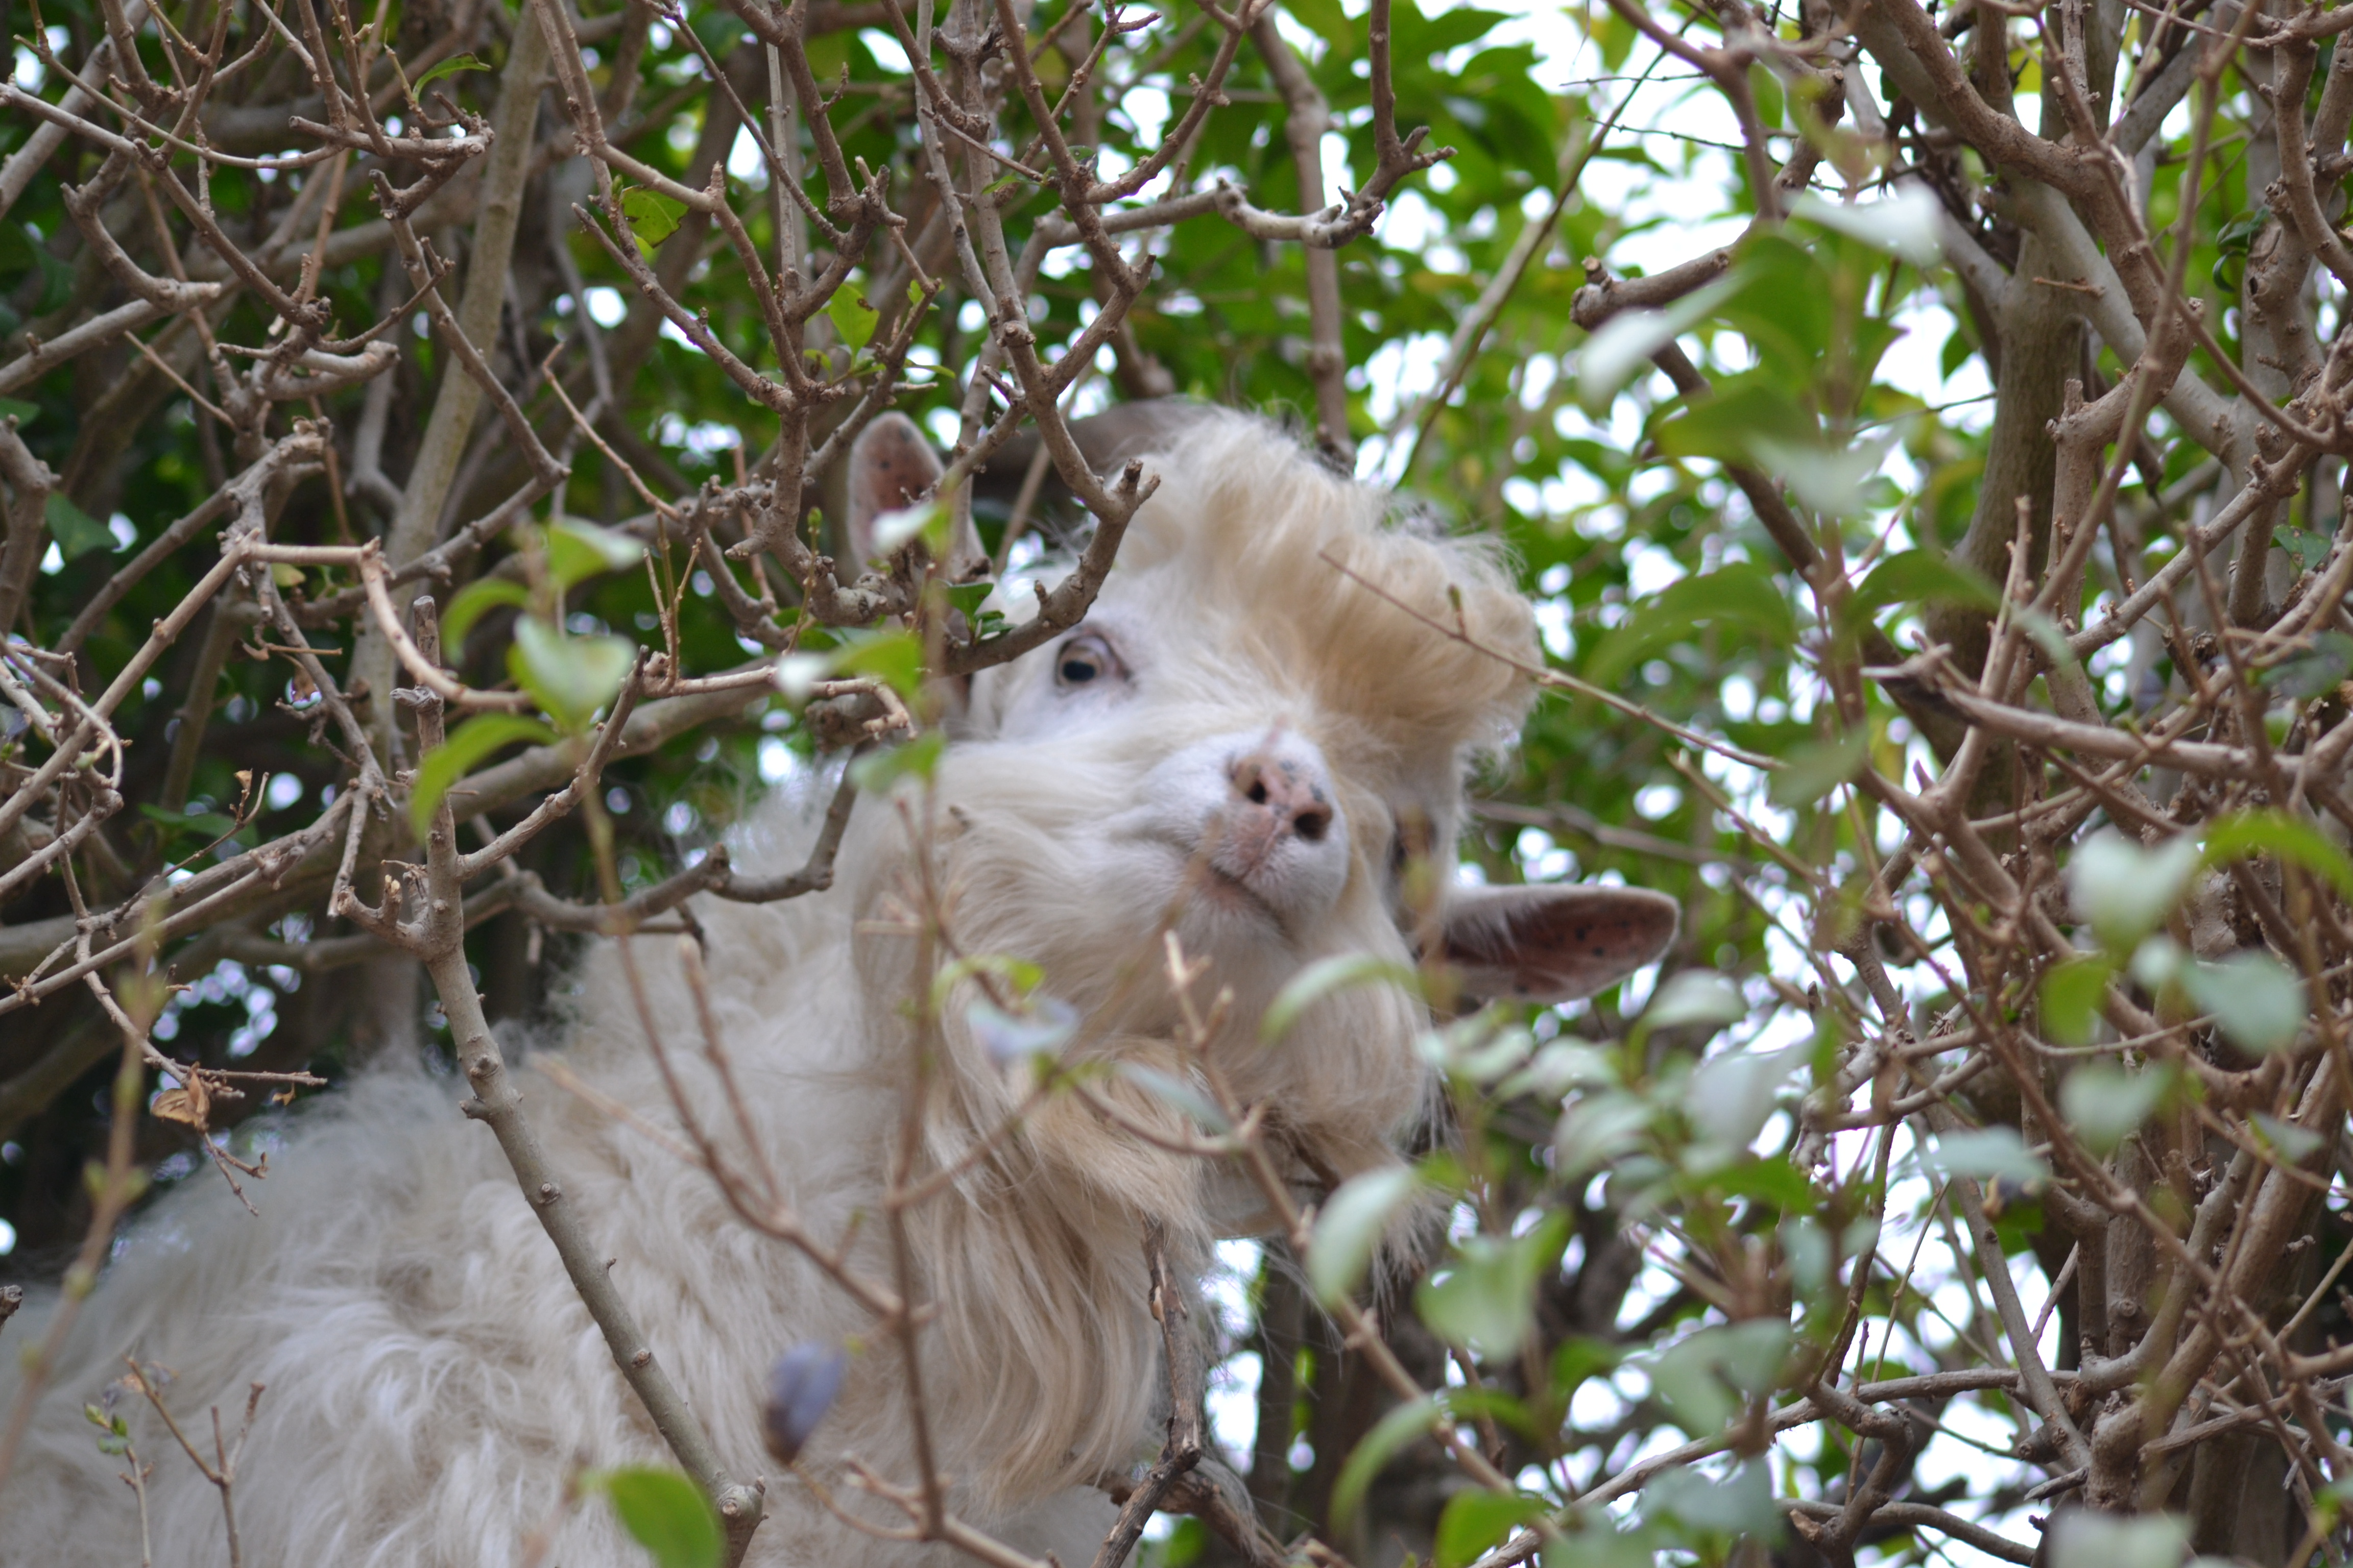
Notes:
And finally, I think we should give the Llandudno goats credit – not only for inspiring some quality t-shirts, but for enhancing the patient experience at St David’s hospice. Here are just a couple of goat appreciation posts made in response to the coverage on Facebook.

Slide 10
Why I wish I’d thought of that
Triumph of the human spirit over repeat setbacks
a regular feature became a fundraising powerhouse
fun and funds into hospice fundraising – despite the darkest of times
Notes:
So to sum up, I wish I’d thought of the St David’s goat t-shirt fundraising idea because, as a fundraiser from Llandudno I love it, frankly! But more than that. The t-shirt kept inpatient services running at St David’s Hospice and meant people across North West Wales would have dignity and respect during the end of their lives. - The goat t-shirts are a perfect example of how sometimes the best fundraising ideas are the ones right in front of you – they might even be headbutting your car! St David’s Hospice turned a regular feature into a fundraising powerhouse and brought fun, light and funds into hospice fundraising – even during the darkest of times – and I wish I’d thought of that!

