Slide 1
Pandas or
Playstations?
Nana Crawford, Social Media Manager | British Red Cross

Slide 3
Objective
Put a new spin on Black Friday sales promotions, with a series of Facebook ads urging consumers to adopt animals which are endangered or at risk.
Nana Crawford, Social Media Manager | British Red Cross

Slide 4
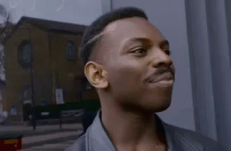
Why I wish I’d thought of it?
Simple
Visually impactful
Memorable
Relatable
Collaborative
Nana Crawford, Social Media Manager | British Red Cross

Slide 5
“
WWF UK wanted a slice of the Black Friday action, but with a little twist on the concept.
We co-created adverts that look like typical ‘sale’ items with sale buzzwords, but you soon realise that the item with limited stock is a vulnerable animal
Ciara Harrison, creative strategist at Meta
Nana Crawford, Social Media Manager | British Red Cross

Slide 6
Method
Facebook & Instagrams creative hub
Flash sale of ‘limited stock’
Top 3 black friday categories - Tech, fashion, beauty
Content created in 2 days
Use of stock images
Static & video ads optimised for mobile
Spirit animal messenger bot
Clear call to action - adopt an animal

Slide 7
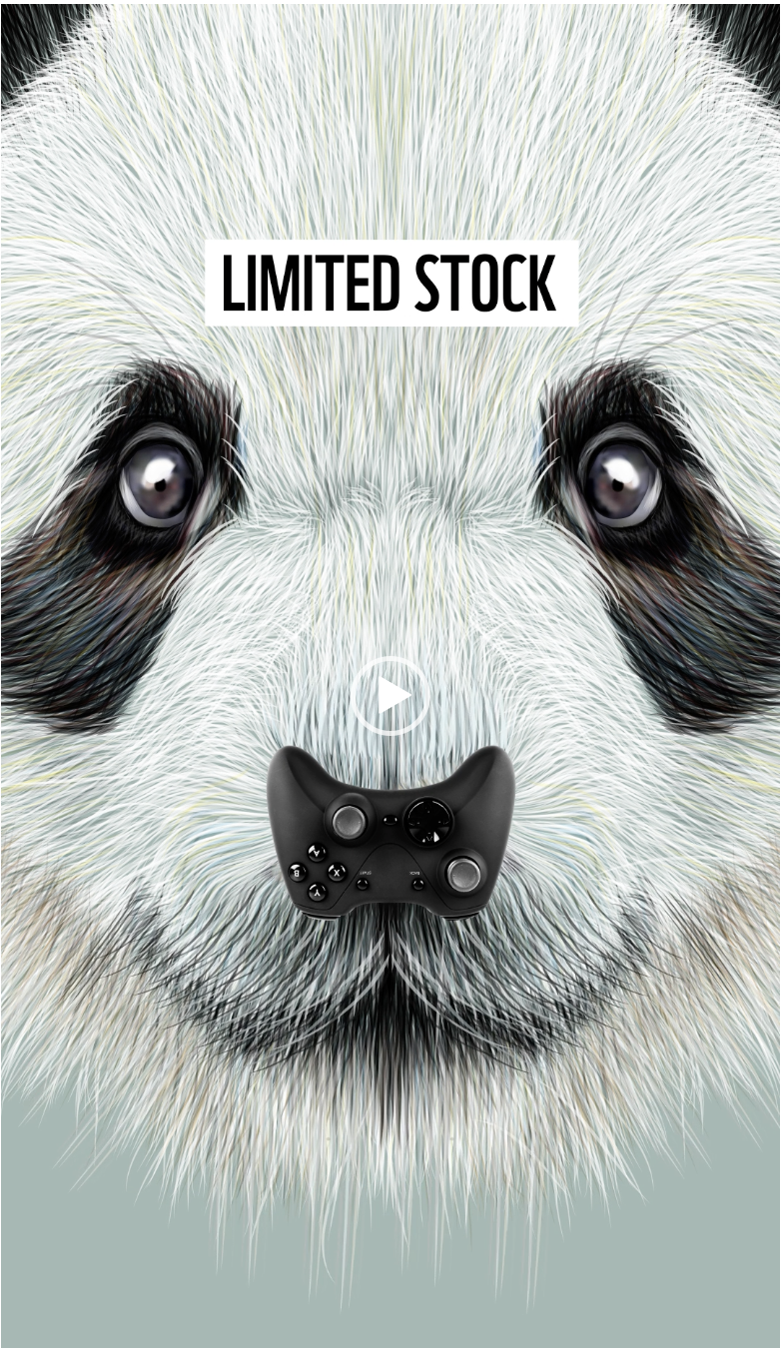
Results
Over 58,000 visits to WWFs UK website
Over 2,000 new adoptions
Alongside £3,000 in donations raised through Facebook fundraiser using campaign creative
Followed by Christmas campaign - ‘adopt a better future’

Slide 8
Learnings
Creative collaboration
Skillshare opportunities
Facebook & Instagram creative hub
Notes:
Tips about fundraisers working with teams to capitalise -

Slide 9
Thank you

