Slide 1
Rob Williams, War Child UK

Slide 2
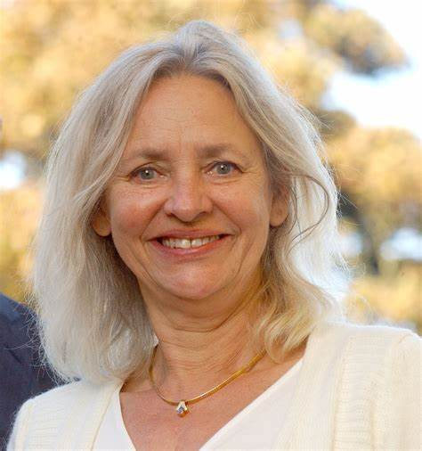
Boudewijn Poelmann
Annemiek Hoogenboom

Slide 4
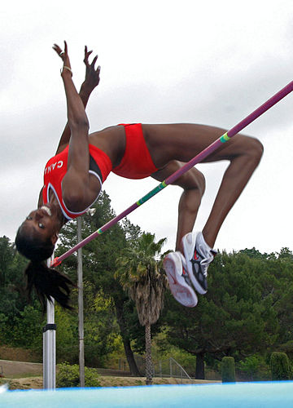
Breakthrough thinking
The world high jump record is 2.5 metres
What if you want to jump higher?

Slide 5
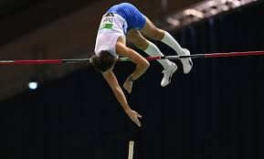
Pole vaulting
If you want to jump higher than 2.5 meters
You need some original thinking

Slide 6
Lotteries – a shared reward

Slide 7
Lotteries – a shared reward

Slide 10
Why a postcode lottery?
It’s a different kind of monthly affiliation
Lots of charities. Something for everyone
Neighbours win together
Great stories in local newpapers
Peer marketing
Its about community
Low cost of acquisition

Slide 11
The model is expanding
1989 Holland
2005 UK and Sweden
2016 Germany

Slide 12
£11 billion donated to charities since 1989
13 Million Subscribers

Slide 13
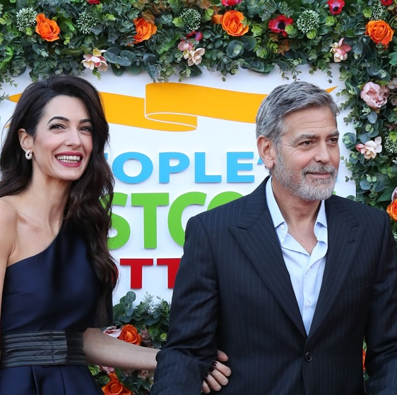
Brilliant Execution
Scale!
Commercial marketing
TV shows/DRTV
High level endorsements – Nelson Mandela, Bill Clinton, George Clooney
A low cost granting model – unrestricted giving
Very focused on small number of metrics
number of players
percentage donated to charities

Slide 14
Measured by annual donations, the Peoples Postcode Lotteries are the third largest private foundation in the world – beaten only by The Welcome Foundation and the Bill and Melinda Gates Foundation

Slide 15
Boudewijn Poelmann
Annemiek Hoogenboom

