Slide 1
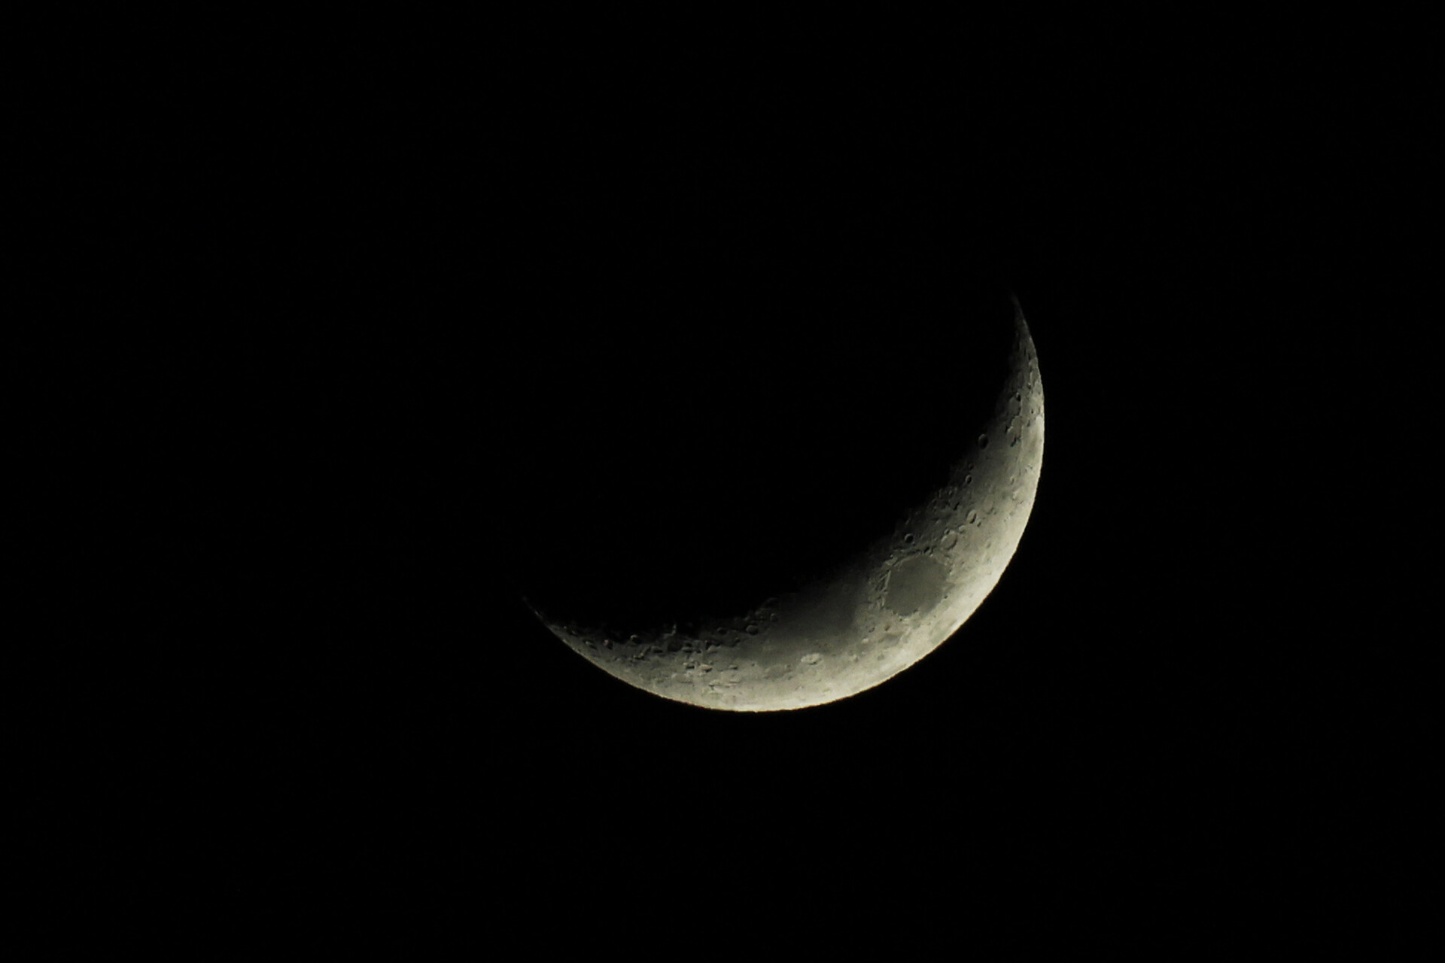
I wish I’d thought of doing Ramadan the right way

Slide 2
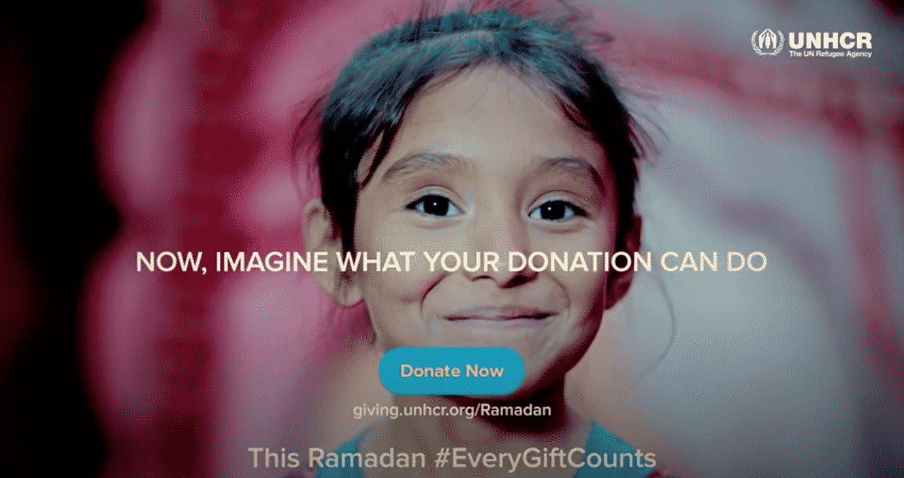
Notes:
What we can see here is the just the tip of a very fat iceberg

Slide 3
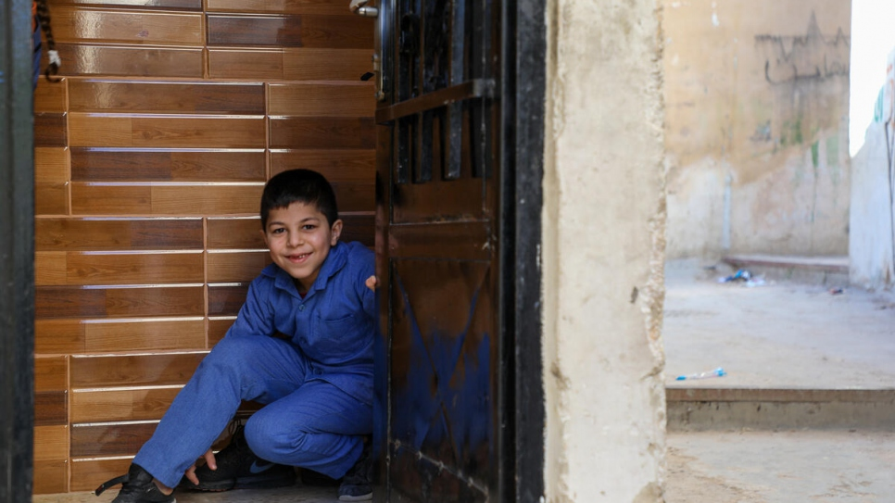
Since its global launch three years ago, the annual campaign has raised more than US$106 million

Slide 4
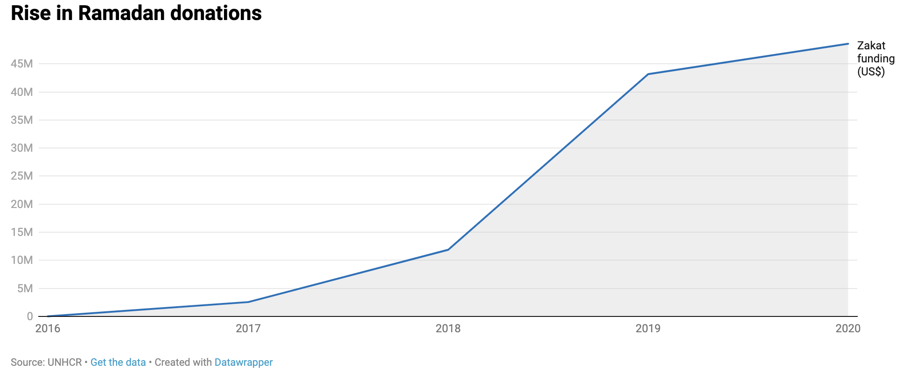

Slide 5
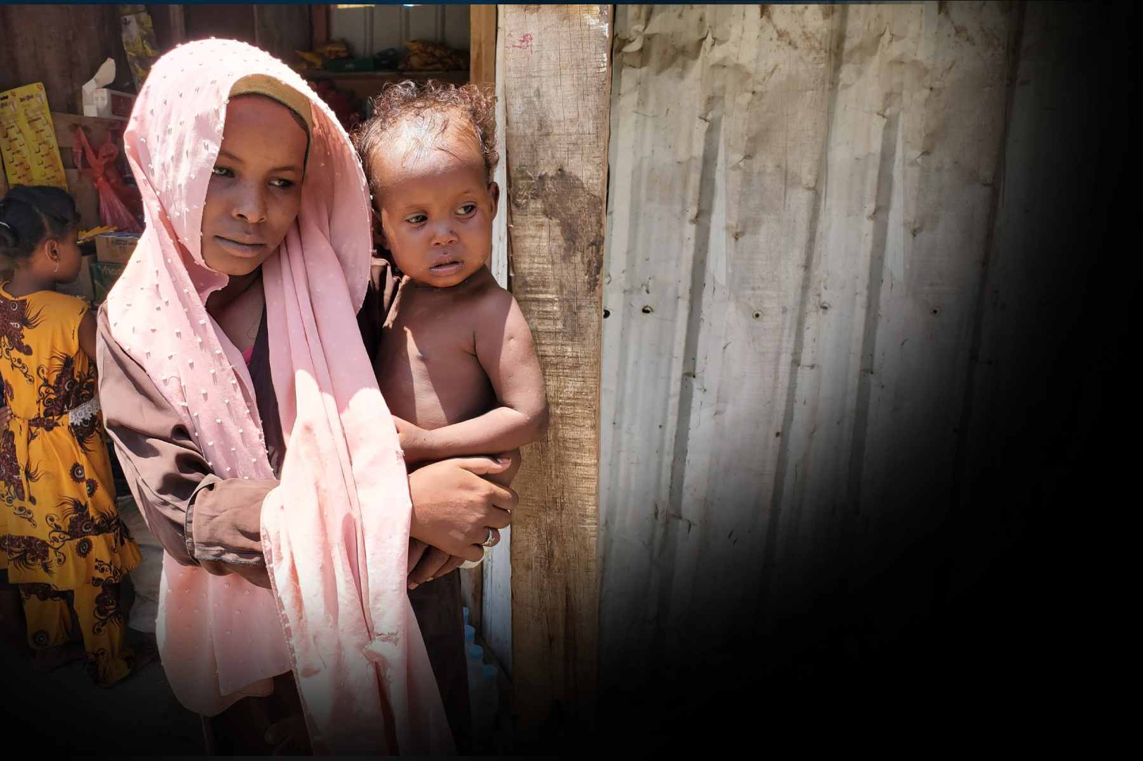
Not just another fundraising appeal

Slide 6
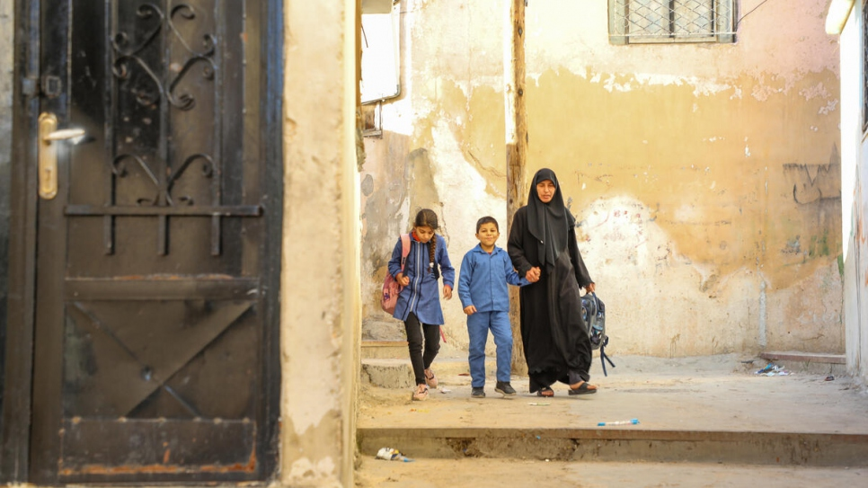
3 years of research
Full backing at all levels across the organisation
Islamic philanthropy is a full strategic aim
Gold standard in Zakat
Fully endorsed and trusted

Slide 7
Notes:
What we can see here is the just the tip of a very fat iceberg

