Slide 1
Who gives a crap
I wish I’d thought of that!
Wendy Plumb , Samaritans
Nov 2022

Slide 2
Notes:
An average person spends 240 days sat on the toilet
Imagine if your cause had 240 days of one of the most intimate moments in your supporter’s everyday life
Imagine if your cause also connected with an average of two other members of your household
Imagine if your supporters reported feeling happy, good, filled with meaning and empowered to make a difference
And imagine if over 50% or over £5million of your profits were helping build toilets and improve sanitation in the world
Love who gives a crap because it’s a story about understanding consumers’ everyday lives, the art of being able to do better and doing it with purpose and with a beautiful product grown through word of mouth

Slide 3
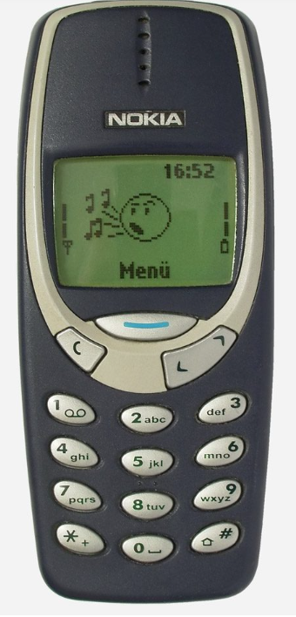
Our biggest competitor is supporter apathy
Notes:
When everyone talks supporter-centricity but have yet to get really close to their supporters and understand how we can get into their lives to anticipate needs they didn’t know they had

Slide 4
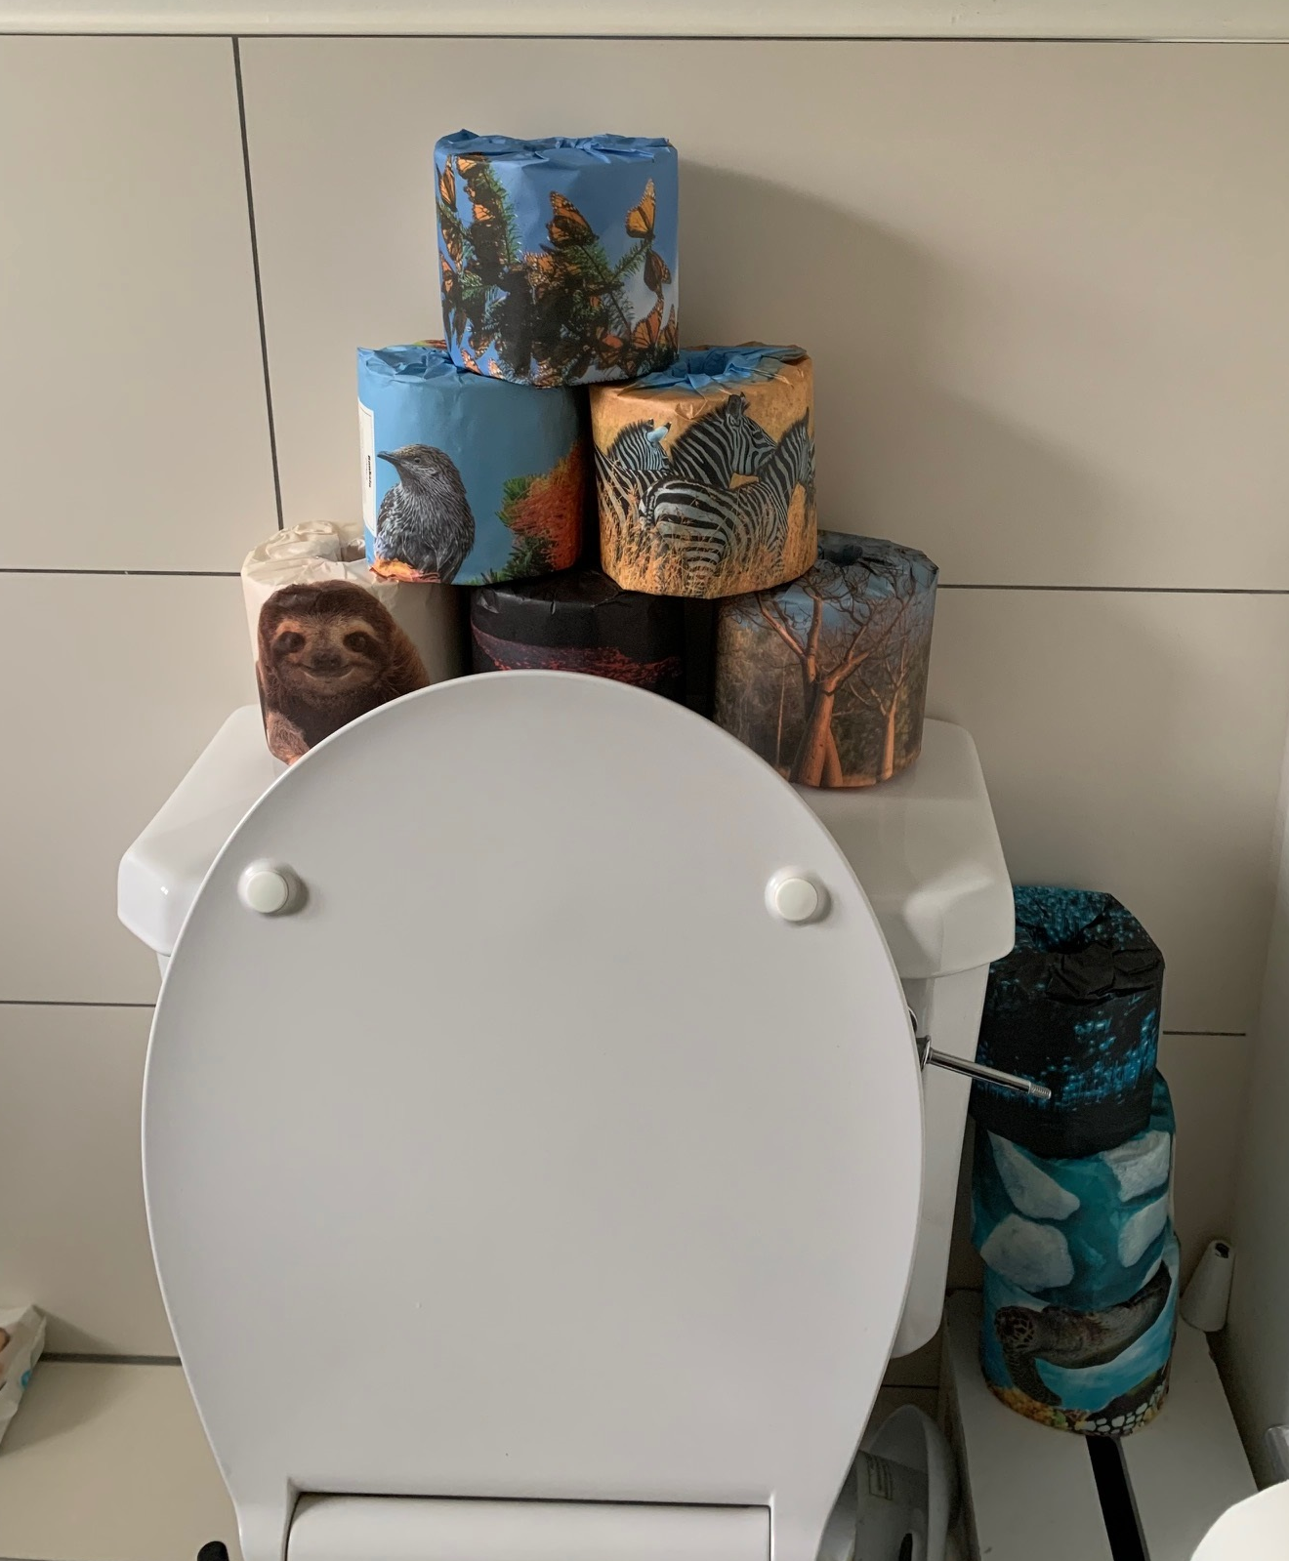
Into our donors’ lives…from the toilet
Notes:
From featuring in toilet life and those who visit – WGAC identified a supporter problem and transformed a household product
Supporter at the heart…brand promise, authentic, purpose led

Slide 5
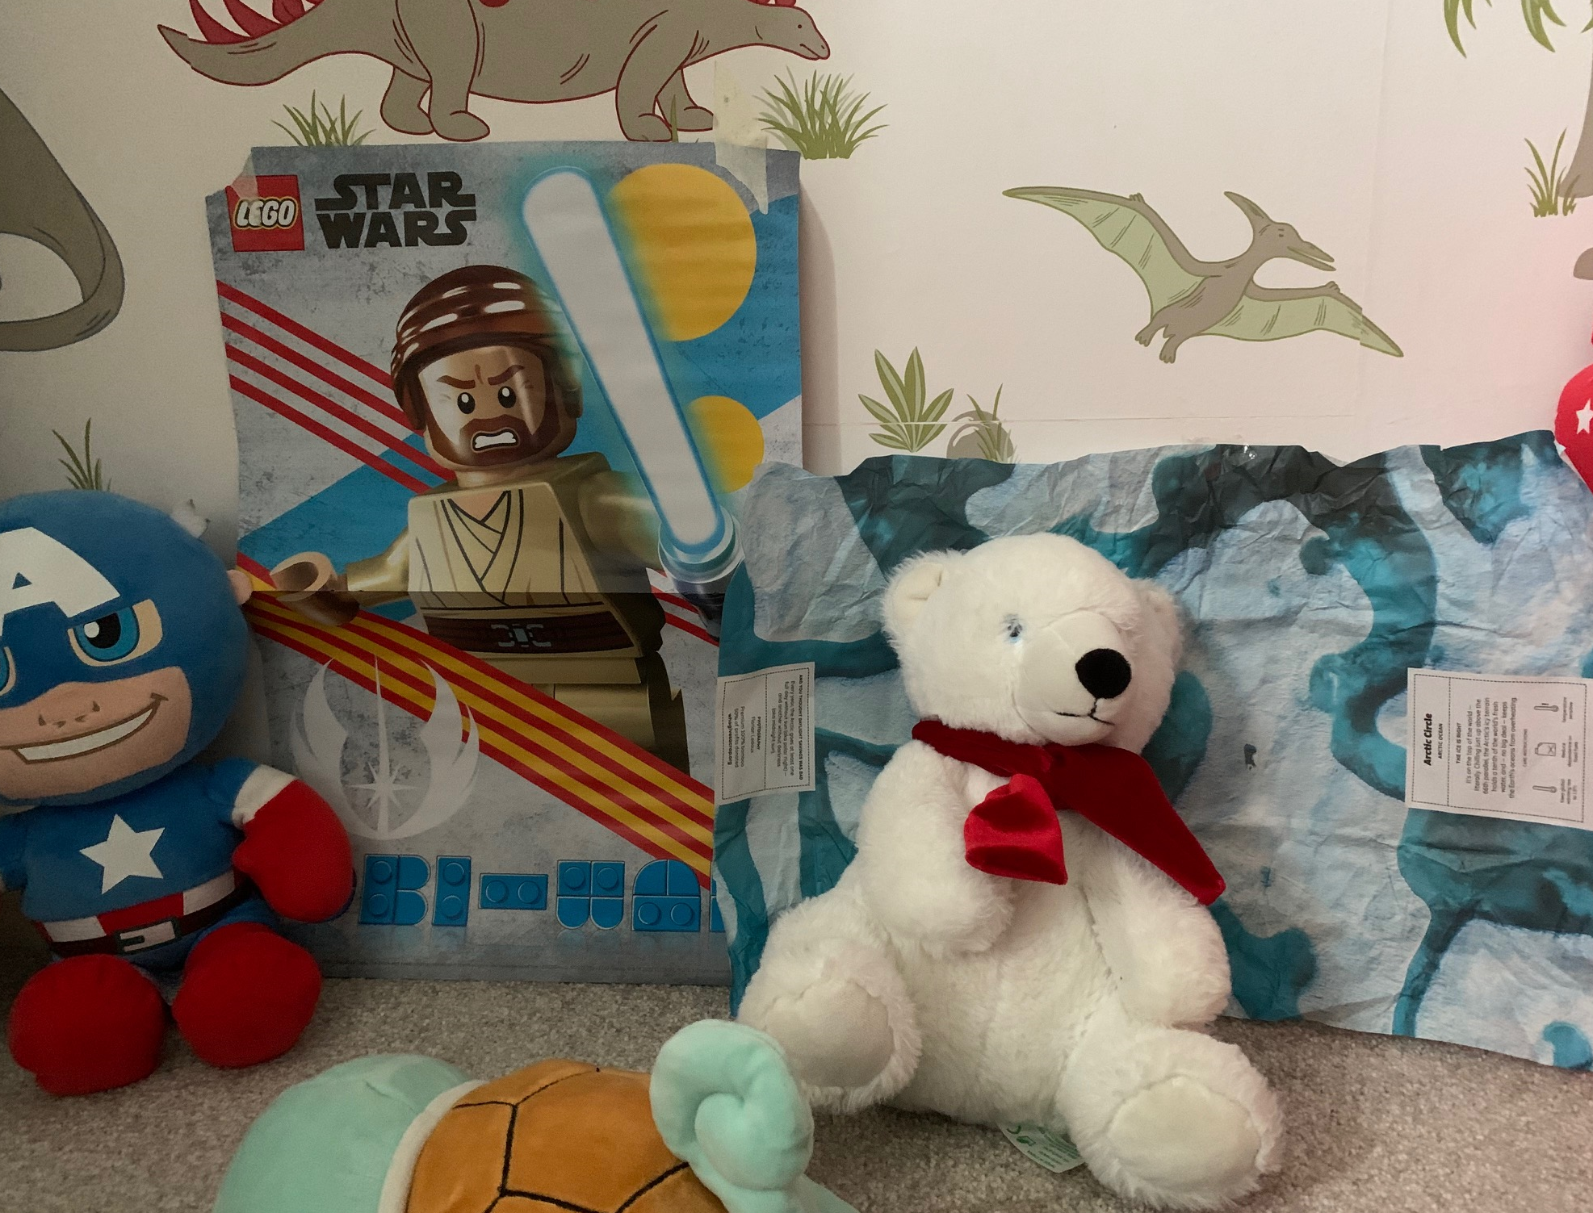
to conversation starter…
Notes:
Blue peter advocated toilet roll crafting…the design engages and mobilises easy conversation starters with the whole family.

Slide 6
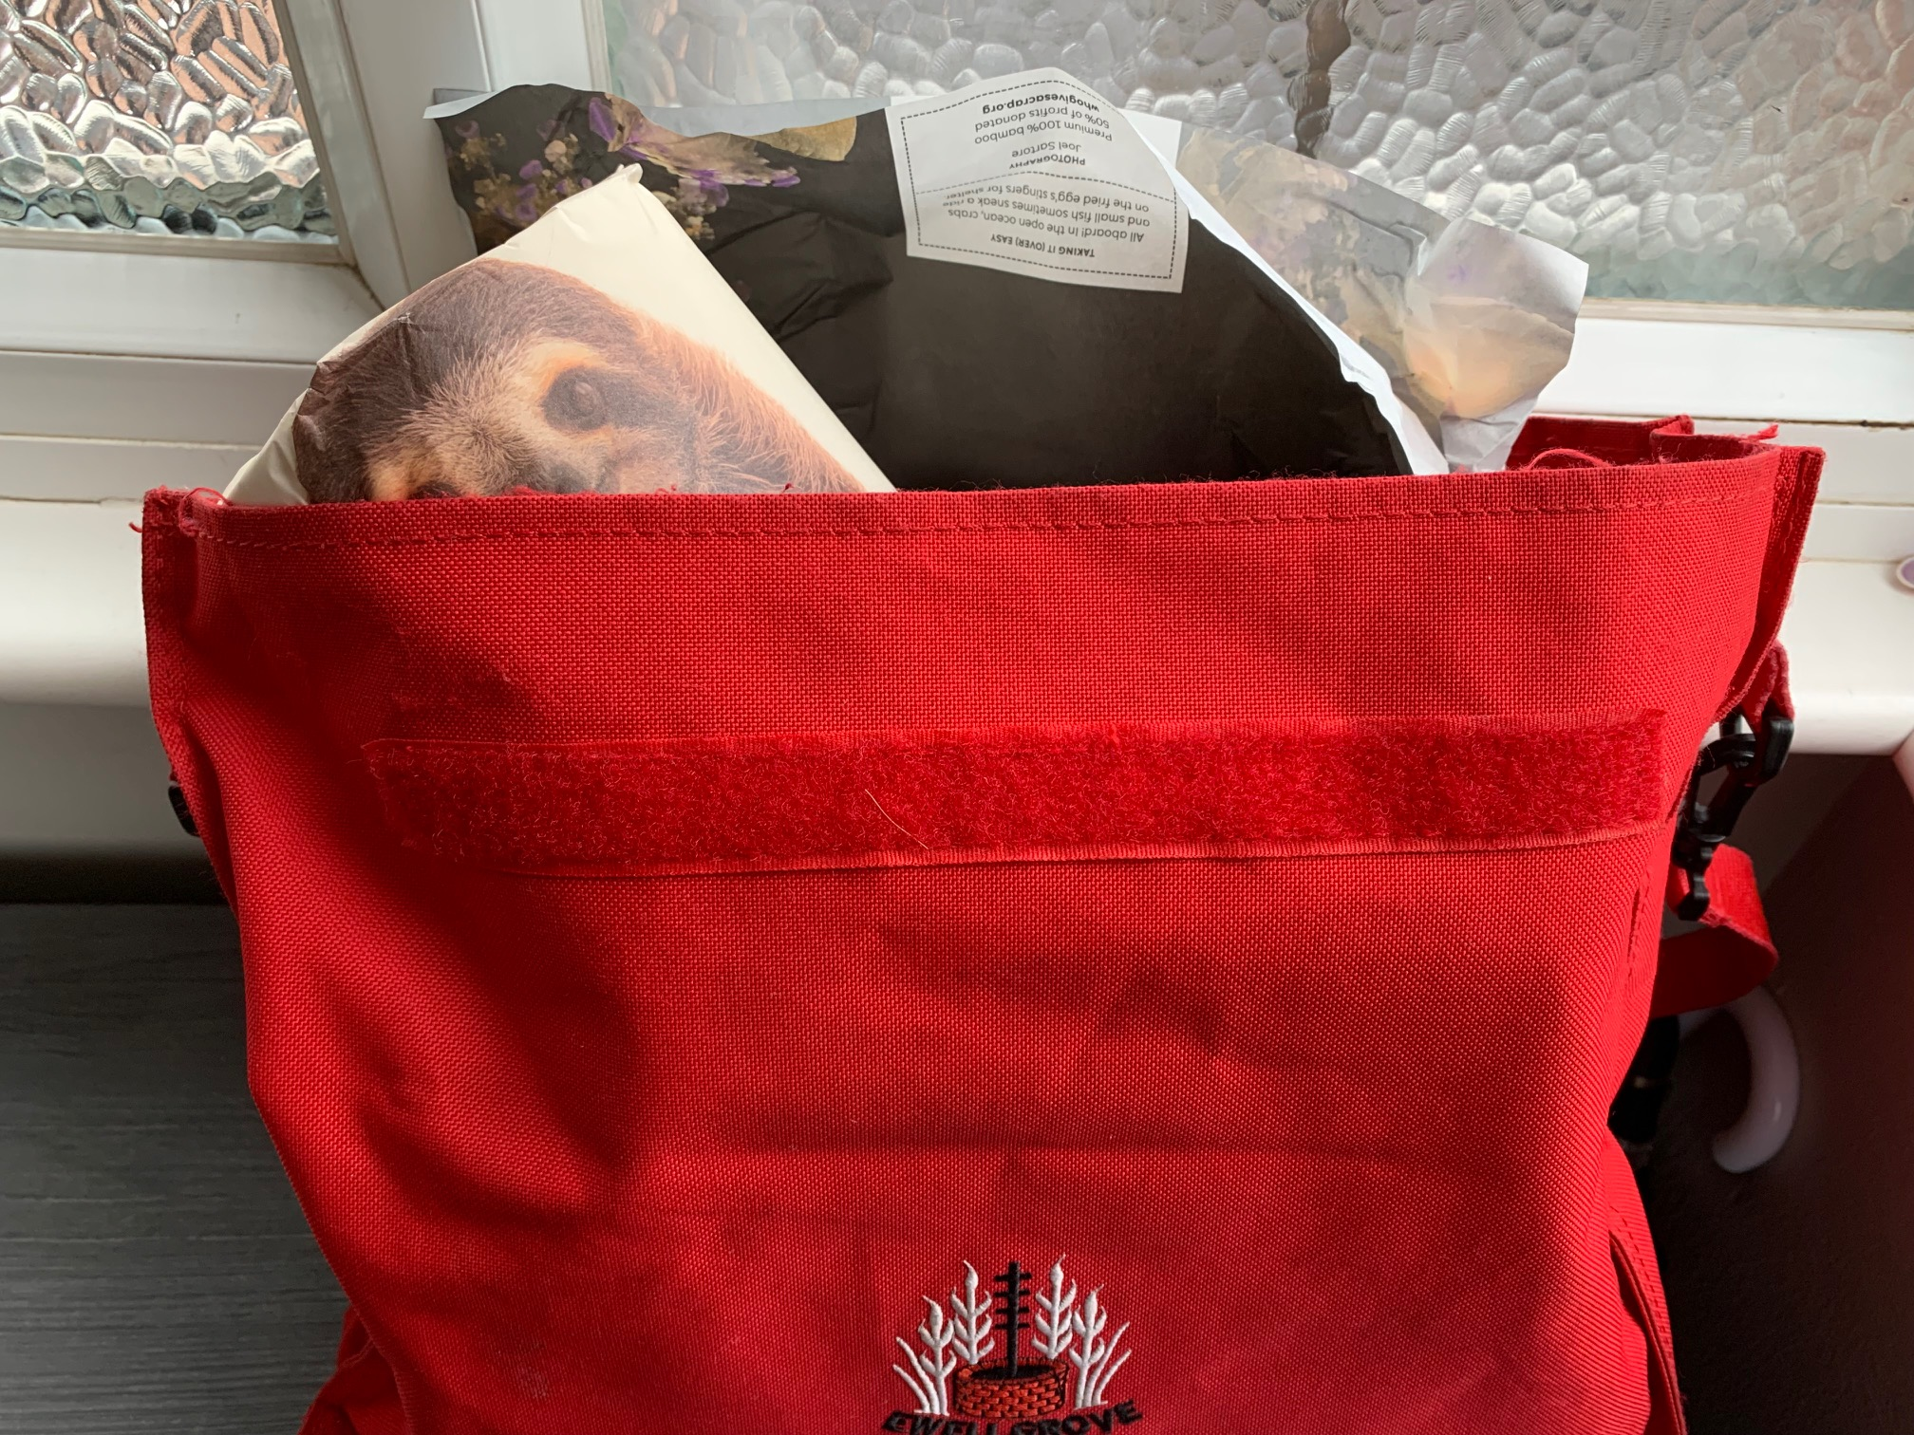
to a budding activist…
Notes:
Mobilising us all. Impact of young child telling 28 other young children about why protecting the planet is important.

Slide 7
Inspiration points
From big teams dedicated to insight to small budgets there are options to listen and walk in the shoes of our donors and supporters
“Blend gut intuition with data insight…and weird it out”
Feedback is a gift
Keep evolving

Slide 8
Results
Over £5 million donated to help sanitation and build toilets across the world

Slide 9
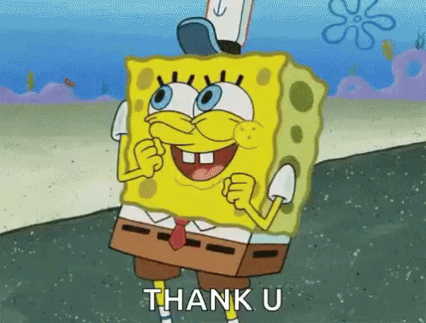
Thank you

Slide 10
Appendix

Slide 11
Do good
Champion the environment
GAINS
Peace of mind
Convenience
Feel good, feel happy
Competitively priced to Andrex
JOBS TO BE DONE
Show off design
Buy toilet roll supply to last
Be the first
Customer Needs
Ensure value for money
Quality wipe for the skin
PAINS
Environmentally friendly
No paper in the toilet
Run out of household supplies
Be different
Wasteful paper use
Make a difference
Price for quality
Storing loo rolls
Notes:
Our biggest competitor is apathy – this is how what supporters want…a DM pack with ask, thank you, you made a difference…
WGAC innovated with custo
Straight shooter – straight talking focus on ease and convenience of getting loo roll delivered
Environmentalist – wants easy call to actions to save the world – instructions on using product as a deed starter garden
Cherry picker – Environmentalist with a small e but wants an experience
mer at heart….
Less – story on touchpoint Mya as activitst…campaigning and fundraising…inspire….conversation has started…(school bag imagery)

