Slide 1
Step up in your Leadership Development
Gabi Field
Outgoing Director of Fundraising and Communications at Refuge
LinkedIn- gabi_fundraiser

Slide 2
How I prepared for the step up
Comfortable vs uncomfortable
50% of Job Description
Interview prep
Notes:
How did I know I was ready
Did I have concerns beforehand
Advice on securing that first role

Slide 3
What support I put in place for my role
Mentors
Clear objectives
From peer to manager- boundaries
My strengths and skills as a leader

Slide 4
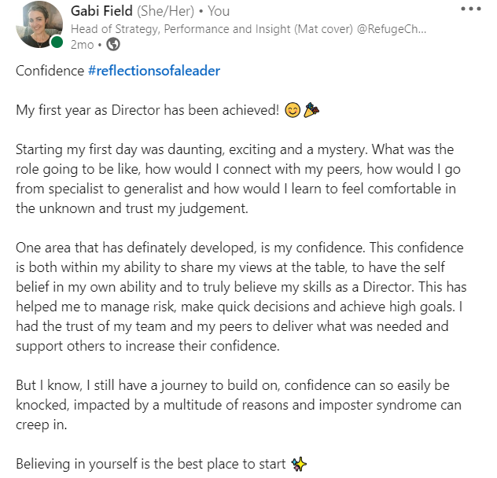
Learnings from my first year
25 areas of reflection
Specialist to Generalist
Vulnerability, Honesty and Trust
Ask all the questions

Slide 5
Top tips
Confident in your leadership strengths and skills
Self awareness
Mentors and coaches
Ask all the questions
Learn from the interview process

