Slide 1
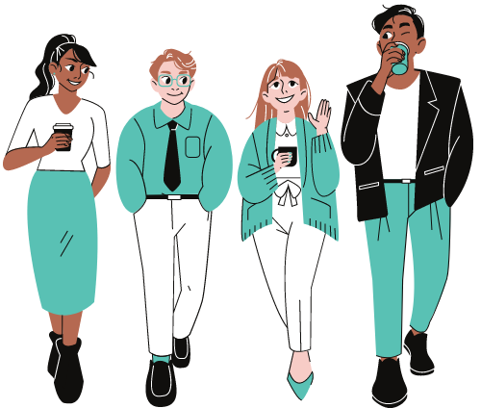
Autistic wellbeing at work
We’re autistic civil servants sharing our personal experiences to improve understanding of autism in the workplace. We’re not HR professionals or certified trainers.

Slide 2
Introductions
Jesse Ni Mhaonaigh
Operations Lead
Anna Goddard-Jones
Events Lead
Cross-Government Autism Network (CGAN)
Cross-Government Autism Network - GOV.UK (www.gov.uk)

Slide 3
What is autism? (title slide)
A very… very brief overview

Slide 4
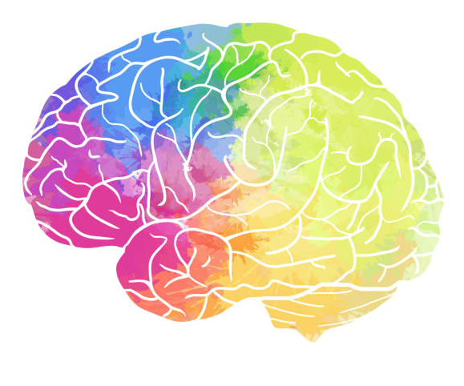
What is autism?
Neurodevelopmental condition
How the brain developed
Not an illness (can’t be cured or treated, but can be managed)
Areas primarily impacted:
Communication
Routine
Sensory
Social
A spectrum (more on that later…)
A protected characteristic
Autism Spectrum Conditions (ASC) are protected as a disability under Section 6 of the Equality Act, 2010.
This is because autism is:
(a) a physical or mental impairment, which
(b) has a substantial and long-term adverse effect on a person's ability to carry out normal day-to-day activities.
Notes:
Speakers notes:
Autism is a neurodevelopmental condition - not an illness, can’t be cured
Impacts 4 areas: communication, routine, sensory, social skills, … which we will dive into later on
Autism is a disability and is covered by the Equality Act 2010 because it is a… and b…
Autism is not a mental health condition.
It is a spectrum! What is the spectrum? …

Slide 5
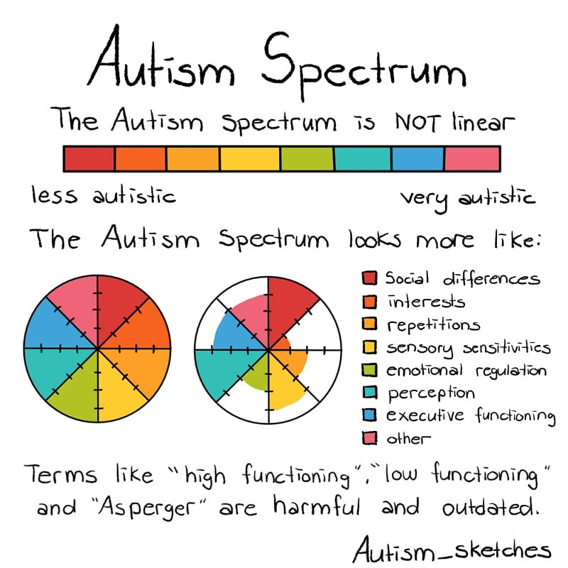
What is the autism spectrum?
It’s a spectrum, not a scale
Notes:
Speaker’s notes:
You may hear the diagnosis of Autism Spectrum Condition, Autism Spectrum Disorder or Aspergers (now no longer used as a diagnosis)
All means the same thing
So whilst we may share some strengths and challenges
But all autistic people are not the same
We can have strengths and challenges in different areas as you can see on the slide.
There’s no such thing as “only a little autistic” or “very autistic”
Labels such as High-functioning and low-functioning labels are outdated terms that misrepresent what it means to be Autistic
This is because if people label you as high-functioning they tend to expect you not to be “too” autistic
That often means expectations are too high and unrealistic
Labels can also prevent someone accessing the necessary support they need if they are not seen as Autistic enough.
It’s a spectrum, not a scale.

Slide 6
How should we talk about being autistic?
Identity first (“autistic person”)
Person first (“person with autism”)
Autism is often part of our identity
Ultimately, it’s up to the individual
Respect people’s choices about how they like to refer to themselves
If in doubt, ask!
Notes:
Speaker’s notes:
What is the issue with the language ?
The language we use effects the meaning and the meaning we attach to words has wider implications (i.e., how we think about or react to something).
Now the main dispute around language is generally over identity-first or person-first language
Identity-first language e.g. “Autistic person”
Person-first language e.g. “person with Autism”
Disability and Autism Networks generally encourage the use of identity first language e.g. Autistic person instead of person first language e.g. person with Autism.
For many of us autism is a core part of our identity
e.g. influencing our likes, dislikes, strengths and challenges.
Others may consider Autism to not be part of an individual's identity, hence “person with Autism”
This may be because for many years Autism or being Autistic has been associated with negative terminology.
It also suggests people can be separated from their autism or that Autism is something that can be taken away.
Ultimately what we say it is up to the individual which they prefer
Make sure to ask what someone prefers if you aren’t sure
It is important that we respect Autistic people’s choice in how they like to refer to themselves.

Slide 7
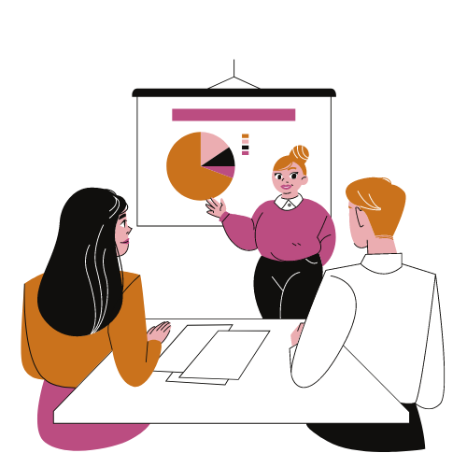
Common autistic strengths
Visual thinking, learning, and recall
Clear and direct communication
Attention to detail, pattern recognition
Intense focus and tenacity
Excellent long-term recall
Honesty, loyalty, and integrity
Methodical, analytical approach
Strong respect for truth, facts, and rules
Creative thinking, innovative solutions
Accepting of difference, questioning norms
Notes:
-These are some common strengths of Autistic people
- For example mine are…..choose top 3……this makes me good at because

Slide 8
Common autistic challenges
Autistic people may struggle with:
Ambiguity (e.g. vague instructions)
Verbally conveying complicated information
Navigating and prioritising complex tasks
Working in busy, loud or sensory overwhelming environments
Finding the average workday more tiring than colleagues
Notes:
These are some of our common challenges, and these will differ from person to person
Mine are…choose top 3….this means…

Slide 9
Autism at work
Our experiences in the workplace

Slide 10
Autistic employment rates
29% of working-age autistic people in the UK are in full-time or part-time employment
Only half (54%) of working age disabled people are in employment (82% for non-disabled people)
Autistic people had some of the lowest employment rates in 2021 (up from 22% in 2020)
Disabled people are less likely to be:
managers, directors or senior officials
in professional occupations
employed full-time
Notes:
Link to ONS figures: https://www.ons.gov.uk/peoplepopulationandcommunity/healthandsocialcare/disability/articles/outcomesfordisabledpeopleintheuk/2021
Speakers notes:
Employment rates for working-age autistic people in the UK are 29%, in comparison 84% of non-disabled people and 54% of working age disabled people are in employment.
Autistic people have some of the lowest employment rates, and disabled people are also less likely to be managers/directors/senior officials, in professional occupations, and/or employed full-time.

Slide 11
What is it like to be autistic at work?
DISCLAIMER : This will not represent the experiences of all autistic people!

Slide 12
Autistic Differences
Sensory
Autistic brains process sensory information differently from non-autistic brains.
Communication
We’re often visual thinkers; we may struggle to process information we hear. We may ask clarifying questions as we often process language differently.
Cognitive
Autistic people’s brains are likely to struggle with executive functioning, including planning and prioritising.
Social
Autistic people can have very different tolerances and expectations for social interaction than non-autistic people.
Notes:
Speaker’s notes:
[Speaker can talk about personal example(s)]
One of the key feature of autism is communication differences
Quite often these differences are misinterpreted as something else
For example, we may fidget when speaking which may come across as an indicator that we are lying and untrustworthy.
We may interrupt and come across as rude.
Linking with the previous, we may not know when to speak and so not speak at all.
We may ask more clarification questions which could come across as us being unprepared or uninformed.
We may go off on tangents a lot.
We may take sarcasm or idioms seriously, coming across as naïve.
We may overshare which could make us seem unfocused.

Slide 13
How do these differences affect wellbeing at work?

Slide 14
Sensory
Own desk
Noise cancelling headphones
Office days = meeting days
Controlling your calendar
Office move around day
Low sensory spaces
Work Uniform
Notes:
Sensitivity to lights, smells, sounds and other factors can be heightened in autistic people.
Autistic people are prone to hypersensitivity to stimuli. In an office autistic people can often:
Hear all the sounds at the same level. People chatting, computer noises, phone dings, the lights above, a car outside they are all hear and felt at the same level, trying to focus in on one can be impossible.
Smells can be overwhelming and upsetting.
Lighting can be too bright and cause headaches.
All this and more can make it difficult for an autistic person to work in an office environment.

Slide 15
Communication
Communication preferences
Key points emails
Chairing meetings
Hands ups to speak
Add an email signature
Highlight actions/questions in communications
Notes:
Double empathy problem – A theory that autistic people and non-autistic people have such different experiences that they can struggle to empathise with each other, and this can lead to frequent misunderstandings. The theory states that it is not a deficit in communications skills or empathy on either side but a difference which can lead to misunderstandings.
It can be difficult to join a conversation, know when to speak and when to end an interaction.
In teams' meetings – a good chairperson and a hands up policy should be in all meeting possible. This is because this method ensures everyone has their turn and no one dominates the conversation. It can help autistic people not come across rude and introduces rules. In person, do not demand eye contact or stop talking when someone looks away. Pointing out someone is not making eye contact can be embarrassing and end any conversation.
Find your communication method and ask for this to be used when possible
Add an email signature – I am neurodivergent….
Lead in your communication style.
Ask clarifying and clear question.
Highlight actions and questions in emails.
No matter how hard you try, sometimes you cannot understand what someone means. This can be so tiring, having meeting after meeting with people who appear to be talking in riddles and you know there is something implied, but you can’t figure out what.

Slide 16
Cognitive
Share to-do list with manager
Colour code with priority
Soft and Hard deadlines
Work uniform
Book in your lunch/lunch buddy
Put yourself on red (Teams)
Have set times to check emails and messages
Take breaks, download apps set alarms.
Notes:
Name some things you put in place to help with executive function.

Slide 17
Social
Spend your lunch doing something you enjoy
Advocate for yourself at team events
Say no
Say yes, and…
Join your people group
Solitude

Slide 18
Other Wellbeing Strategies
Build a diverse network
Get a workplace passport
Have frequent one2ones with your manager
Join Neurodiversity (ND) groups at work
Join a CGAN community group
Know your workplace spaces – low sensory rooms, mental health rooms
Know your workplace mental health first aiders
Have a plan in place for when you need time alone
Use your diary – block out your diary
Notes:
Build a diverse network
It is important to have a diverse network of people and spread out who you speak too. This can be overwhelming and difficult especially if you have an aversion or anxiety when around other people. I find it helpful to treat this like work and have a stakeholder of me map. I have difficulties when knowing who to speak to, if this is appropriate, can I trust this person. This is exacerbated when I am not at full power.
Get a workplace passport
Have frequent one2ones with your manager
Join ND groups at work
Join a CGAN community group
Know your workplace spaces – Low sensory rooms, mental health rooms
Know your workplace mental health first aiders
Have a plan in place for when you need time alone

Slide 19
Stakeholders of me
HR
Pam Assist
Family
Partner
Co-Workers
Work Mentor
Line Manager
What do I need?
Solve a problem
Vent about an issue
Complain about unfairness
Be inspired
Take control of a situation
Take my mind off an issue at work
Discuss work related stress
Seek guidance

Slide 20
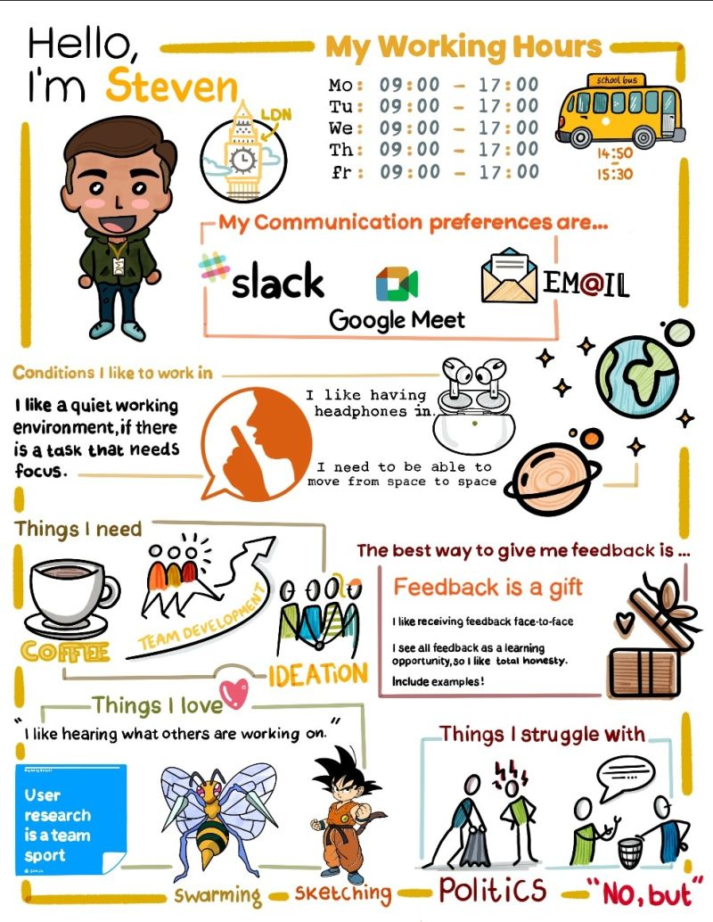
Manual of me
Work hours… I work 8am - 4pm Tuesday to Friday
Communication preferences … If you have time, I like short teams' calls with cameras on. For actions, please send these in emails with clear subject headers.
Conditions I work in… I like to work in the office. I travel regularly around different offices. I do not accept meetings on Fridays unless urgent.
How I like to receive feedback…. Feedback should be direct and straightforward. I am very comfortable with criticism but get confused when it is mixed with positive feedback. Please be clear when feedback is positive or negative and do not mis (for instance a compliment sandwich). I may ask additional questions, but this is not because I am upset, but rather because I want to understand to improve.
Things I love… I love working with people in person, taking time away from my desk and getting a cup of tea when talking to co-workers. I like taking my lunch alone as it allows me to recharge.
Things I struggle with… I struggle with reading between the lines and body language.
Notes:
Lots of teams in the civil service have taken on ‘manuals of me’. They are a great tool for introducing new team members and act as a reference for others when they need to communicate with you.
Putting this information in writing ensures that you have something to link to if someone asks you how you like to work or how you communicate.
There are great templates online for this and are a great team activity. They encourage seeing each other as individuals and give an opportunity to talk about why you have these preferences.

Slide 21
Disclosing autism at work
Dear Manager,
I have booked in a one2one meeting with you next week.
In this meeting I would like to discuss:
reasonable adjustments
I would also like to discuss that I am openly autistic, how this information affects how I work and how we can best work together.
If you need further information on autism before the meeting, please let me know and I can send resources.
Kind Regards,
Me
Notes:
It is up to you if you decide to disclose being autistic at work.
You do not need to have a formal diagnosis to get adjustments or help, although some adjustments may only be possible if you have one. If you have a diagnosis, you do not need to disclose it and can just state what you need help with.
To your manager:
Send an email (marked private) to your line manager. Keep It short and simple.
Include the following:
You are going to schedule a meeting to discuss reasonable adjustments
If you disclose autism, you can mention this.
You can include resources if you like, ensure these are short and work suitable.
To your team:
Do you want to disclose to your team? Letting people know 121 can be difficult. If you are confident enough – do a presentation – or organise someone to do a presentation for your team/directorate. You could do a small introduction – e.g Hi I’m Jesse. I work in this department, and I am autistic. I have organised Anna to come along today and speak about being autistic at work. Thank you.
Always remember, you do not owe anyone disclosure.

Slide 22
Workplace Passport
Passports are a cross-Civil Service initiative developed by the Civil Service Workplace Adjustments team.
They are for people with long- or short-term health conditions.
The information is confidential and will not be shared.
Passports should be regularly reviewed.
Notes:
Passports are a cross-Civil Service initiative developed by the Civil Service Workplace Adjustments team. The Workplace Adjustment Passport service was designed to help anyone with a long or short-term health condition requiring workplace adjustments.
Personal details including information on health conditions, barriers affecting work and any supporting information, such as Occupation Health referrals, can be detailed on the passport.
Colleagues have control over the information shared on their passport which means they can be tailored to their individual needs and requirements. Adjustments can then be discussed with their manager and put in place to help make working in DWP more accessible for them.
Passports can be used as an ongoing record of conversations held around adjustments that can be shared with new line managers, so the process doesn’t have to start all over again.
The passport is transferrable across the Civil Service, meaning colleagues can take it with them when they change roles, supporting discussions about their needs with new managers.
A Carer’s Passport is also available and can be used by colleagues to discuss and record the flexibilities needed to combine caring responsibilities and work.

Slide 23
How can I support my colleagues?
Attend our full event – supporting autistic colleagues
Speak to the individual not the neurodivergence
Be open and straight forward
Give clear answers
Know your ambassadors
Know your mental health rooms, quiet spaces, nearby safe spaces for when you feel overwhelmed
Have a plan for meltdowns and other issues that may occur.

Slide 24
CGAN resources
CGAN monthly newsletter – email crossgovautismnet@gmail.com to sign up
Supporting Autistic Colleagues presentations in April and November.
To get updates on when tickets are available, subscribe to our mailing list by emailing crossgovautismnet@gmail.com
Community groups for autistic and non-autistic civil servants.
CGAN Community Groups - Sign Up Form (office.com)
Notes:
FACILITATOR
Thanks so much for coming today.
We will be sending out the slides shortly too, these are for your personal use and should not be shared or used for other presentations.
However, if you would like CGAN to come and give a talk at your department please email us with your request.
Feel free to contact us via email if you have any questions.

