Slide 1
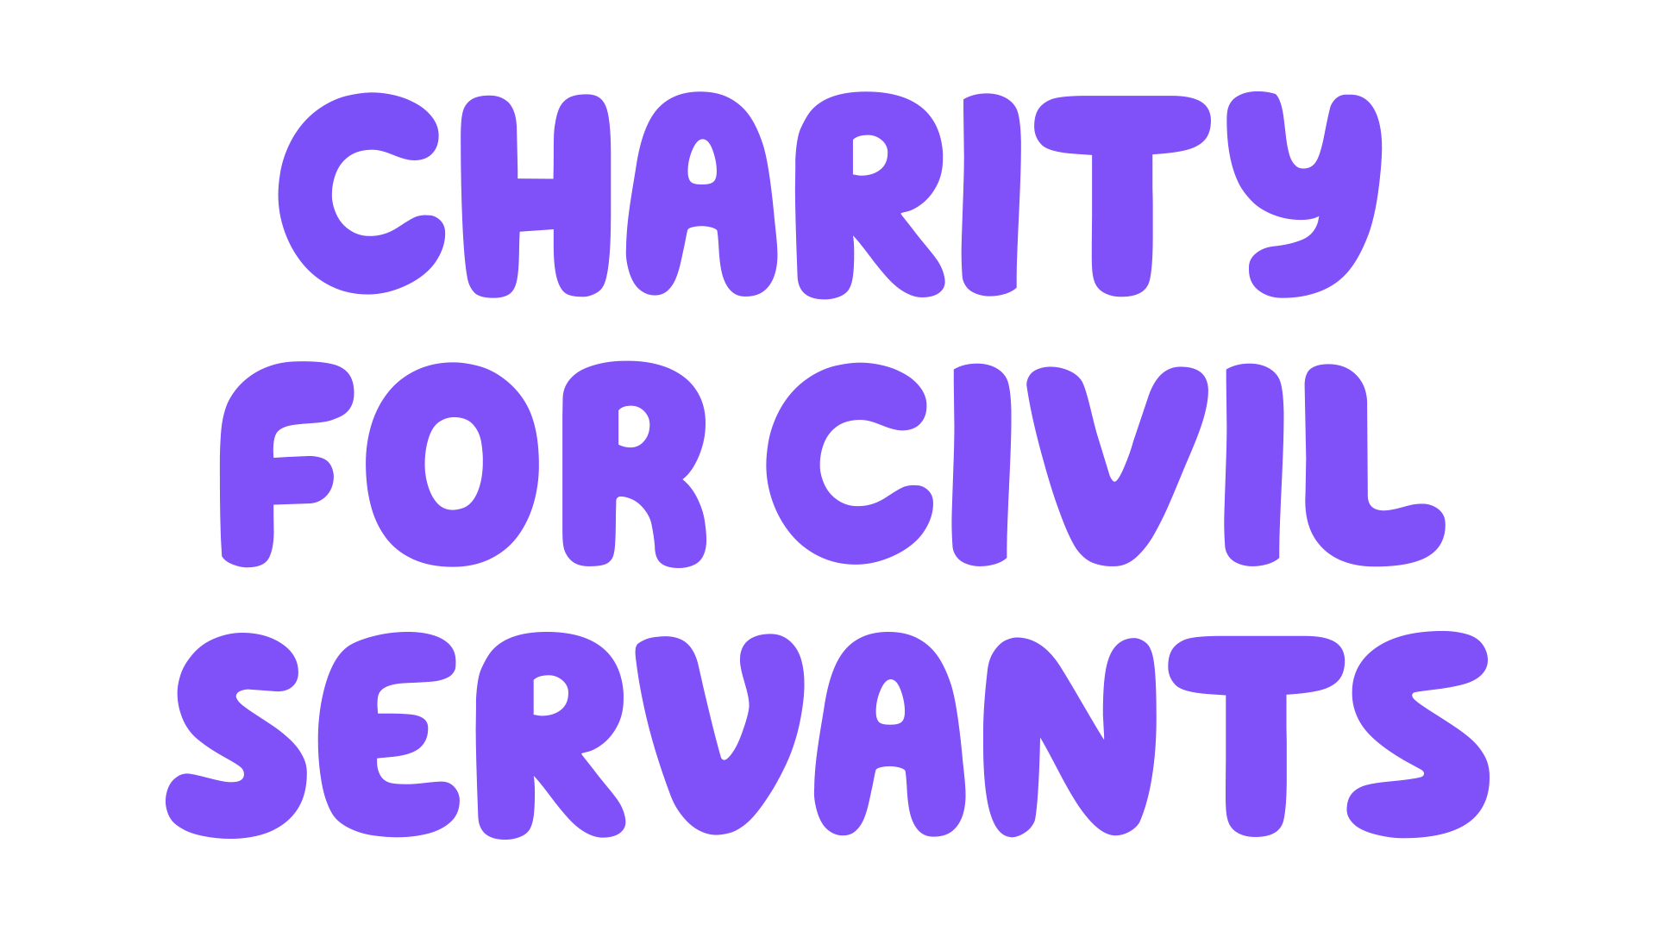
Looking after your wellbeing
cfcs.org.uk
Notes:
Tina
Today we are going to be talking about looking after your wellbeing. But there’s a bit of a spoiler … nowadays we hear quite a lot about wellbeing so it’s unlikely the things in this presentation will be new to you. The challenge therefore will be about whether you want to take action as a result of what we have talked about.
We will give you a tool you can use to think about what needs to change in your life to improve aspects of your wellbeing and it guides you to set yourself some goals if you wish to do so but it is still up to you whether you decide to make changes or not.
It can be easy to imagine that we are stuck, that circumstances prevent us from making changes, that other people need to change to improve things for us. Well, we can sometimes change our situation but we will very rarely if ever change other people so there can be a real benefit in focussing on what we can do for ourselves to improve our wellbeing. (Obviously that doesn’t mean we should not use the channels available to us if we are being treated inappropriately in the workplace!)

Slide 2
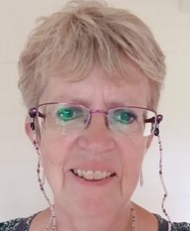
HELLO! It’s great to see you!
Tina Allen​
Caring, Health & Wellbeing Supervisor​
Kath Cheer
Area Services Manager

Slide 3
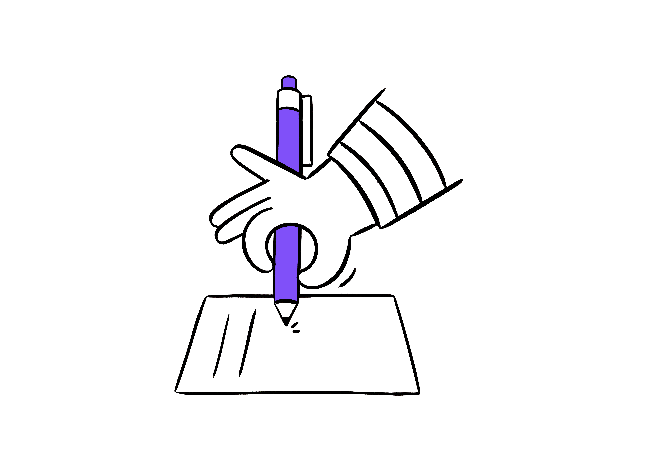
What we will cover today
What is mental health?
Understanding stress
Stress at work
Tips for managing stress
Making changes – and a tool that might help you
And finally a mindful moment
cfcs.org.uk
Notes:
Tina
We are hoping that you will participate as much as you feel comfortable doing in this session, by using the chat function in discussions we suggest and there will also be a few polls to get us thinking. (If appropriate: do be mindful that this session will be recorded so don’t add in comments that you would not want to be read out. For our part, we won’t link names to anything we are reading from the chat and, if we think anything is better dealt with privately, we will contact you after the session.) We also apologise in advance if we don’t get to all comments.
The session should not be too triggering but do make sure you look after yourself and, if anything does touch a nerve, make sure you look after yourself and dip out for a few minutes if you need to.
So, this is what we will cover during the session today.
We will be asking you for your number 1 stress management technique / thing you do to manage your mental health and WB – maybe keep that in mind for later.
But for now let’s think about what the term mental health means to you.

Slide 4
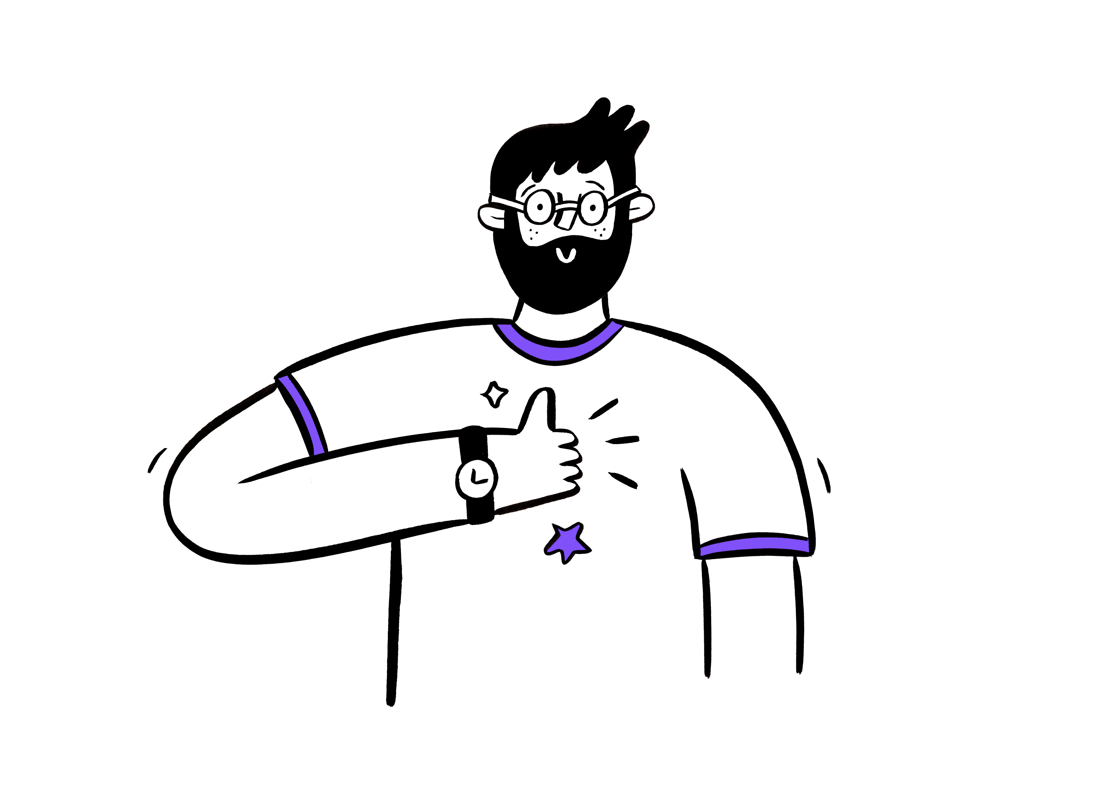
What does the term mental health
mean to you?
Mental health is part of our overall health. The quality of our mental health can be shown by:
How we feel, think and behave
How we cope with the ups and downs of everyday life
How we feel about ourselves and our life
How we see ourselves and our future
How we think about others
How we deal with negative things that happen
Our self-esteem and self-confidence
How stress affects us
cfcs.org.uk
Notes:
tina
Show just the heading to this slide first and ask for comments in the chat.
If possible have one person sharing the slides and one person reading out things from the chat for this bit.
While waiting for comments to come through could say something like
We hear about mental health all the time nowadays but we may mean different things when we are thinking about it and for some it may still be quite a taboo topic. For example, you might be quite happy talking to others about their mental health, but less comfortable talking about yours!
Move discussion forward through comments in the chat. Depending on participation, may not be able to get to all comments.
Then show the slide and explain that this is not a definition but more a description and perhaps shows how wide this issue is.
I wonder which of these surprise you or speak to you? (Presenters could discuss this for a minute or two)

Slide 5
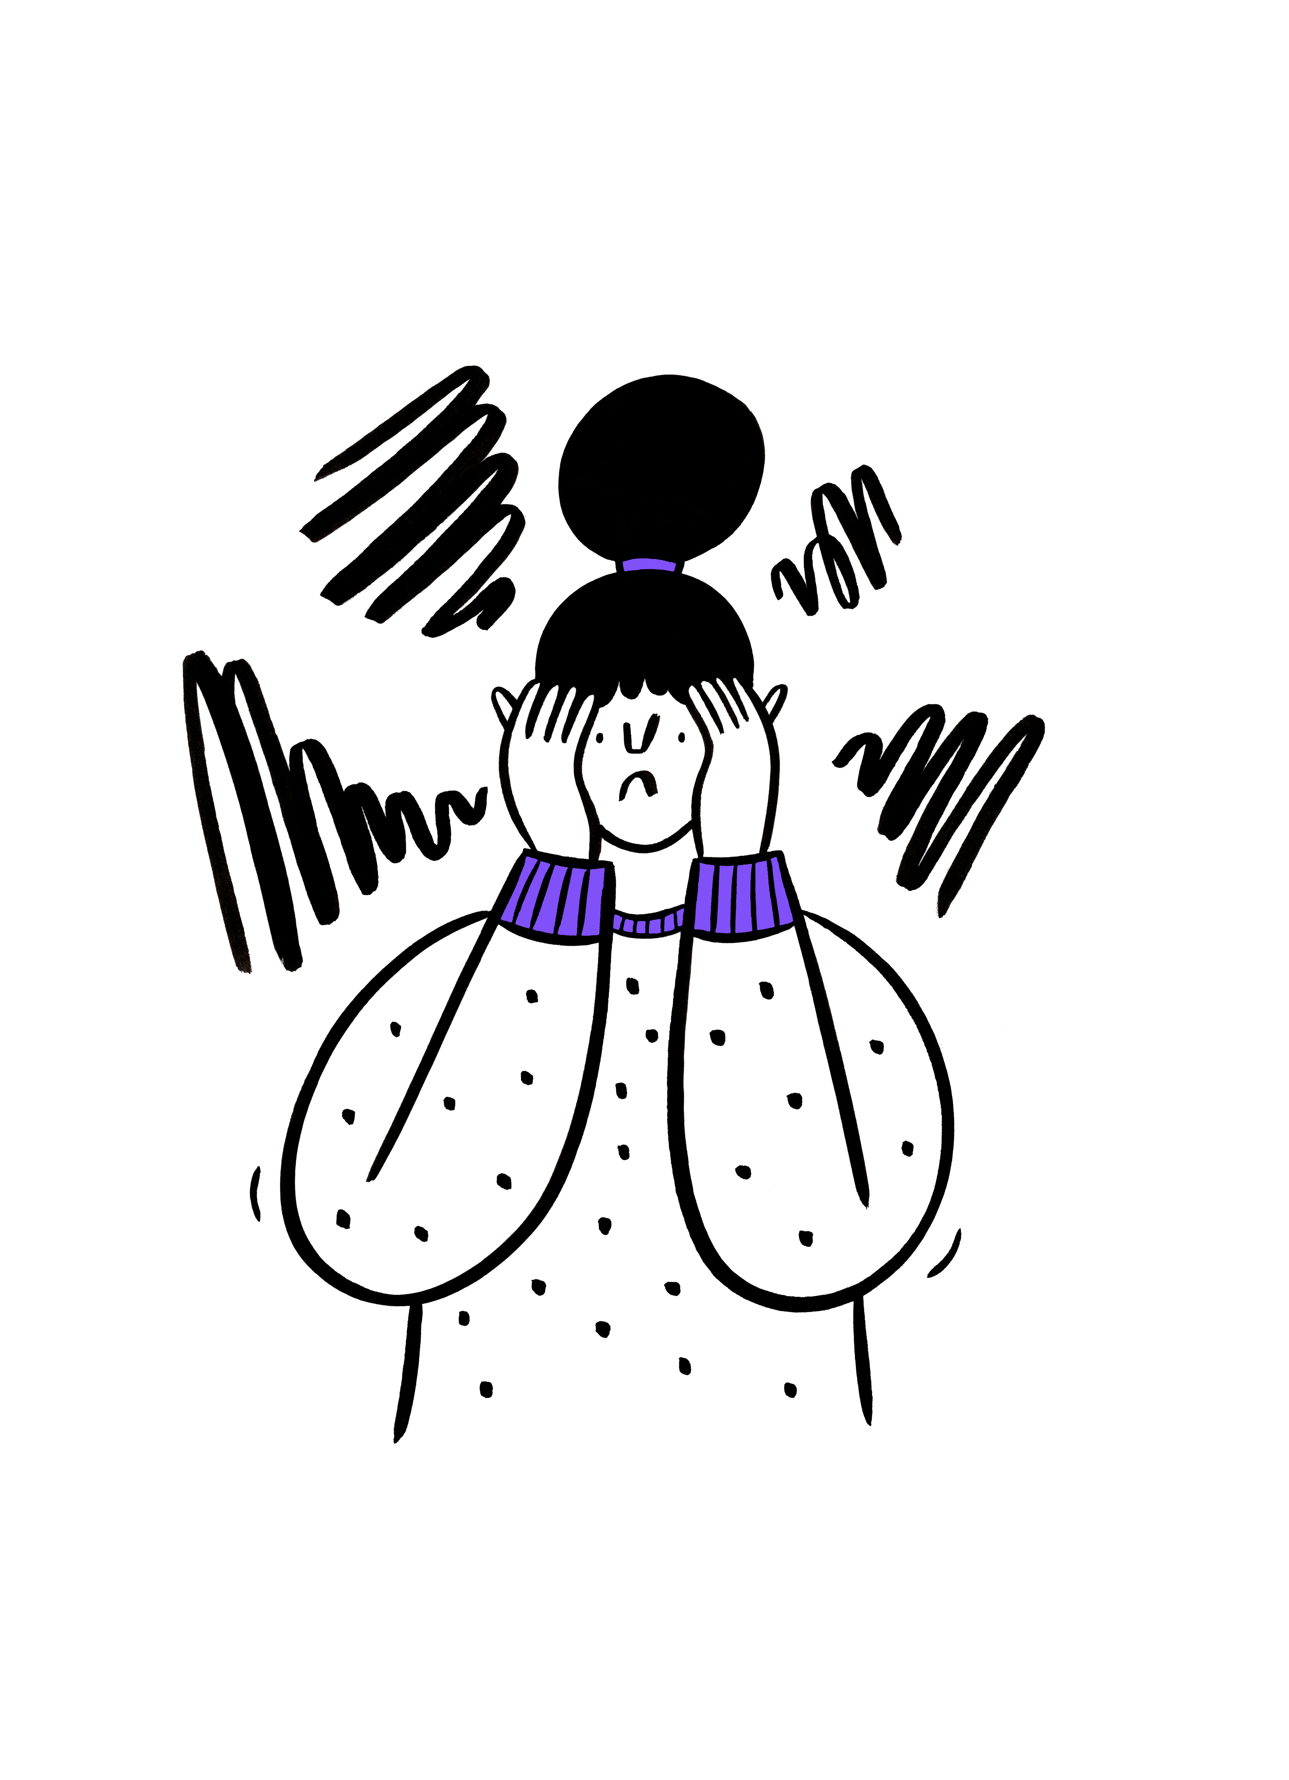
What is stress?
Stress is the body’s reaction to feeling threatened or under pressure
Stress can be helpful in some situations
Too much stress can affect how we feel, think and behave and how our bodies work
Stress is not an illness but it can cause illness and certainly affect wellbeing if it’s not addressed
cfcs.org.uk
Notes:
Kath
Show just the heading on this slide first.- and ask is it is MH condition? Y or N in the chat.
So, the last point on the previous slide was about how stress affects us. You are probably all aware, if you think about it, that there are times when you deal better or less well with stress and we will look at the reasons for this over the next few slides. But first of all let’s think about what stress is.
Put up a poll – is stress a mental illness? (probably get more people who say not but interesting to see)
Then show the rest of the slide and talk through.
It is important to remember that some element of stress is not always a bad thing. Sometimes I like to think about a continuum from pressure to stress, where some pressure can be helpful to ensure we get things done – the pressure to get up in time for work, to catch the train we have bought the ticket for, to complete and task by the deadline and so on and when there is too much pressure it becomes more detrimental – for example too many deadlines looming, an older parent having a fall when your life is already full with work and children.
On the next slide, we will be looking at the symptoms of stress, which we will all experience differently but it is also worth remembering that we are all different so what makes me feel stressed might not affect you at all whereas something that really stresses you might not be an issue for me. I think the risk of being late for something is a good example of this. Some people will make sure they are always early and will be very stressed if they think they are going to be late, whereas others take being late in their stride
Then do another poll – is it easier to talk about stress or about mental health? (likely to get more people who think it’s easier to talk about stress) We might comment on this as well.

Slide 6
Symptoms of stress
We are all different but here are some examples
FEELING … overwhelmed, irritable, anxious or scared. Our self-esteem and self-confidence may be low.
THINKING … racing thoughts, worrying, poor concentration, difficulty making decisions, can’t switch off
PHYSICAL … headaches, muscle aches, dizziness or light headedness, feeling tired, stomach problems, racing heart
BEHAVIOUR … Snapping, avoiding difficulties, working longer hours, drinking or smoking more, crying
cfcs.org.uk
Notes:
Kath
These are some of the symptoms we may experience when we are stressed – talk through these
It is worth thinking about how stress affects you. If you want to put into the chat one or two symptoms you experience, we can read some of them out. They may be things on this slide or you may have other symptoms altogether.
I don’t know about you – sometimes I find that I become aware of some of the symptoms before I realise that perhaps I am feeling stressed. I might find that my thoughts are racing, or I feel really upset or I am much more tired than I think I should be and I have to ask myself why.
I think the thing with this is to be curious about how we are feeling, stepping back from the situation and thinking what we can do to reduce our stress levels. And we will come to stress management tips in a while so you can be thinking of what you would like to share with your colleagues with regards to this.

Slide 7
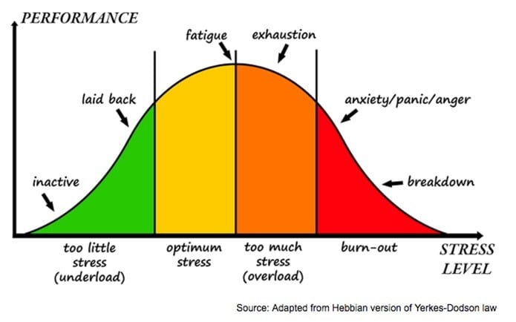
Stress and work
cfcs.org.uk
Notes:
Kath
This slide is really about workplace stress related to workload or deadlines.
We won’t spend ages on it, but it shows, as a general rule, obviously not forgetting that we are all different, that some stress or pressure will improve performance whereas too much can cause exhaustion or even burn-out.
We have a separate recorded presentation about work-life balance which considers burn out in more detail.

Slide 8
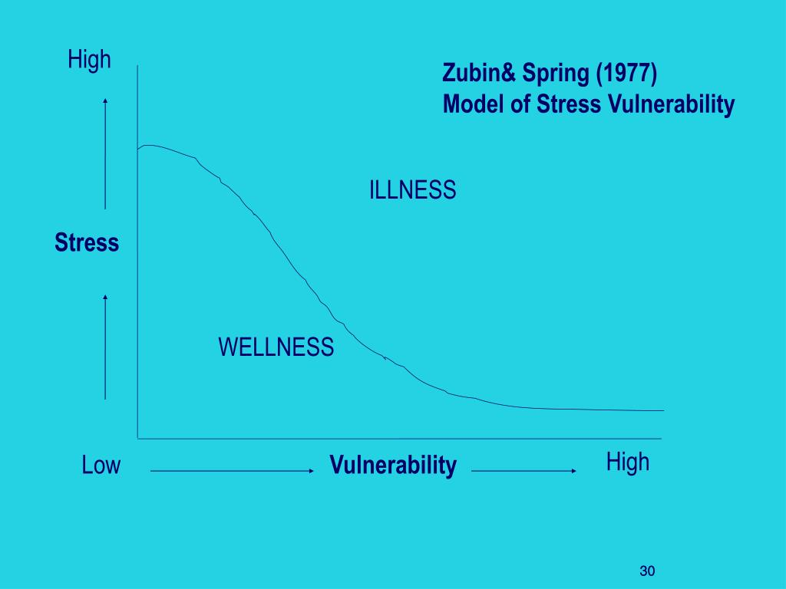
Vulnerability and stress
Stress vulnerability model
cfcs.org.uk
Notes:
Kath
This slide helps us to think about how different people may get stressed more quickly than others.
A colleague may say to you that they are so stressed and they don’t think they can cope with the level of pressure you are all under. You may be thinking ‘you are right we are all under pressure, we just have to push through, if you keel over it will make things even worse’ etc. But the it may be that the stress you are all under is affecting them more than it is affecting you. The stress vulnerability model addresses how our personal vulnerability or resilience impacts how much stress we can cope with. So if you are feeling quite resilient, you will be able to cope with a greater level of pressure than your colleague who has much higher vulnerability. You can see this illustrated by the curve on the diagram. And it is likely that we will be more or less resilient and therefore more or less able to deal with stress at different times in our lives. Vulnerability might be because of an underlying health condition, other things that are going on in your life or even things that have happened in in your past.

Slide 9
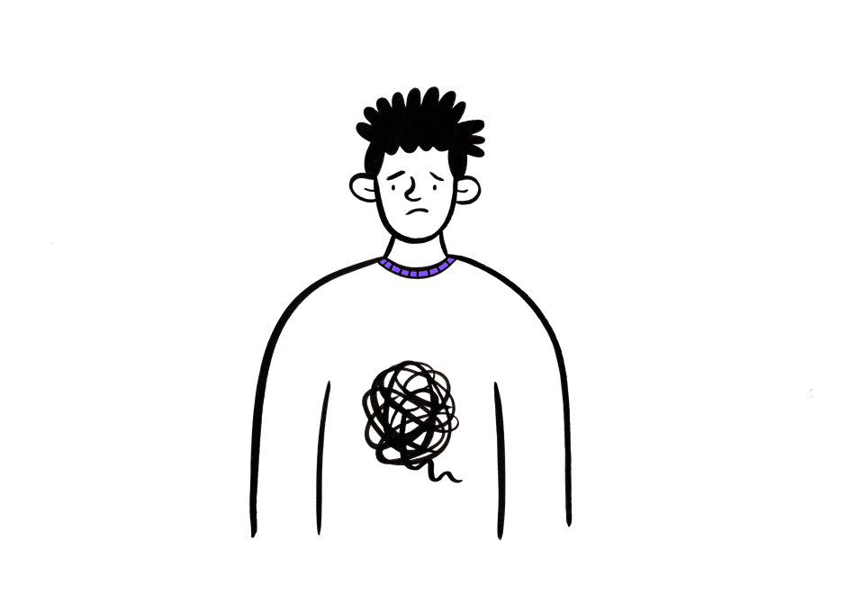
Neurodiversity and stress
Being neurodiverse in a neurotypical world can lead to challenges that may increase the risk of stress, anxiety and depression.
These may cause additional stresses:
Change
Sensory issues
Lack of clarity
Too much information
Masking
cfcs.org.uk
Notes:
Kath
We know that many people who are neurodivergent experience higher levels of stress than their neurotypical colleagues, most likely due to needing to operate in a neurotypical world. This is not a presentation about neurodiversity but we wanted to briefly highlight issues that may be more difficult for colleagues who are autistic or have ADHD or are otherwise neurodivergent.
If you are neurodivergent yourself or have children who are neurodivergent, you will probably recognize some of these issues.
Talk through these issues

Slide 10
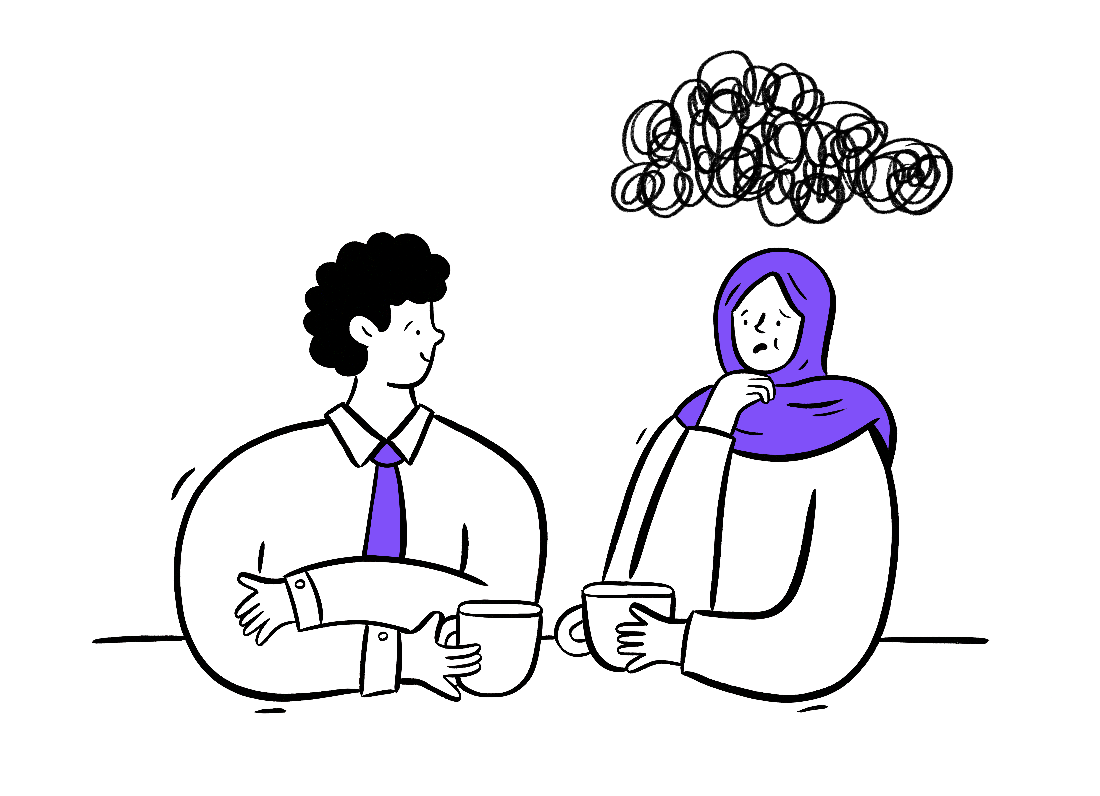
Workplace stress
Workload
Role uncertainty
Lack of control
Support
Relationships
Change
And additional issues for customer facing roles
cfcs.org.uk
Notes:
tina
Show just the heading for this slide.
The HSE and other equivalent bodies in the nations have identified 6-7 main causes of workplace stress. I wonder if we can come up with all of them in the chat. In this, we won’t read out all contributions but the different issues that are mentioned.
One person to read out answers and the other to link them to the HSE categories. Then go through the list and also highlight any that haven’t been mentioned
There may be things you can do to reduce your stress, depending on your situation.
Some examples might be:
A knee jerk reaction to a high workload is to stop taking breaks. There is no research that you will be more efficient or effective if you don’t take breaks. We can all do it over a short space of time if it’s necessary but it is not a long term solution. And we need breaks for our overall wellbeing. We need to eat properly rather than at our desk or on the move, we need time away from our screens, we need to move our bodies. We may also need to think about whether we are working smart when we are working – are you constantly interrupted by emails or colleagues? Can you set some boundaries around that and be properly available for less time rather than partially available all the time?
Some people have found that they are much less engaged with colleagues since Covid because so many people now are working at least partially from home. If you are missing those closer relationships, which perhaps were one of the perks of the job, the chances are you are not the only person to feel like that. Is there something you can do to make a difference? Maybe going into the office when colleagues are there or arranging a chat via Teams.
Some things may be much harder to address on your own of course and you may need to use the in-work supports that are available:
Your line manager, HR, mediation services

Slide 11
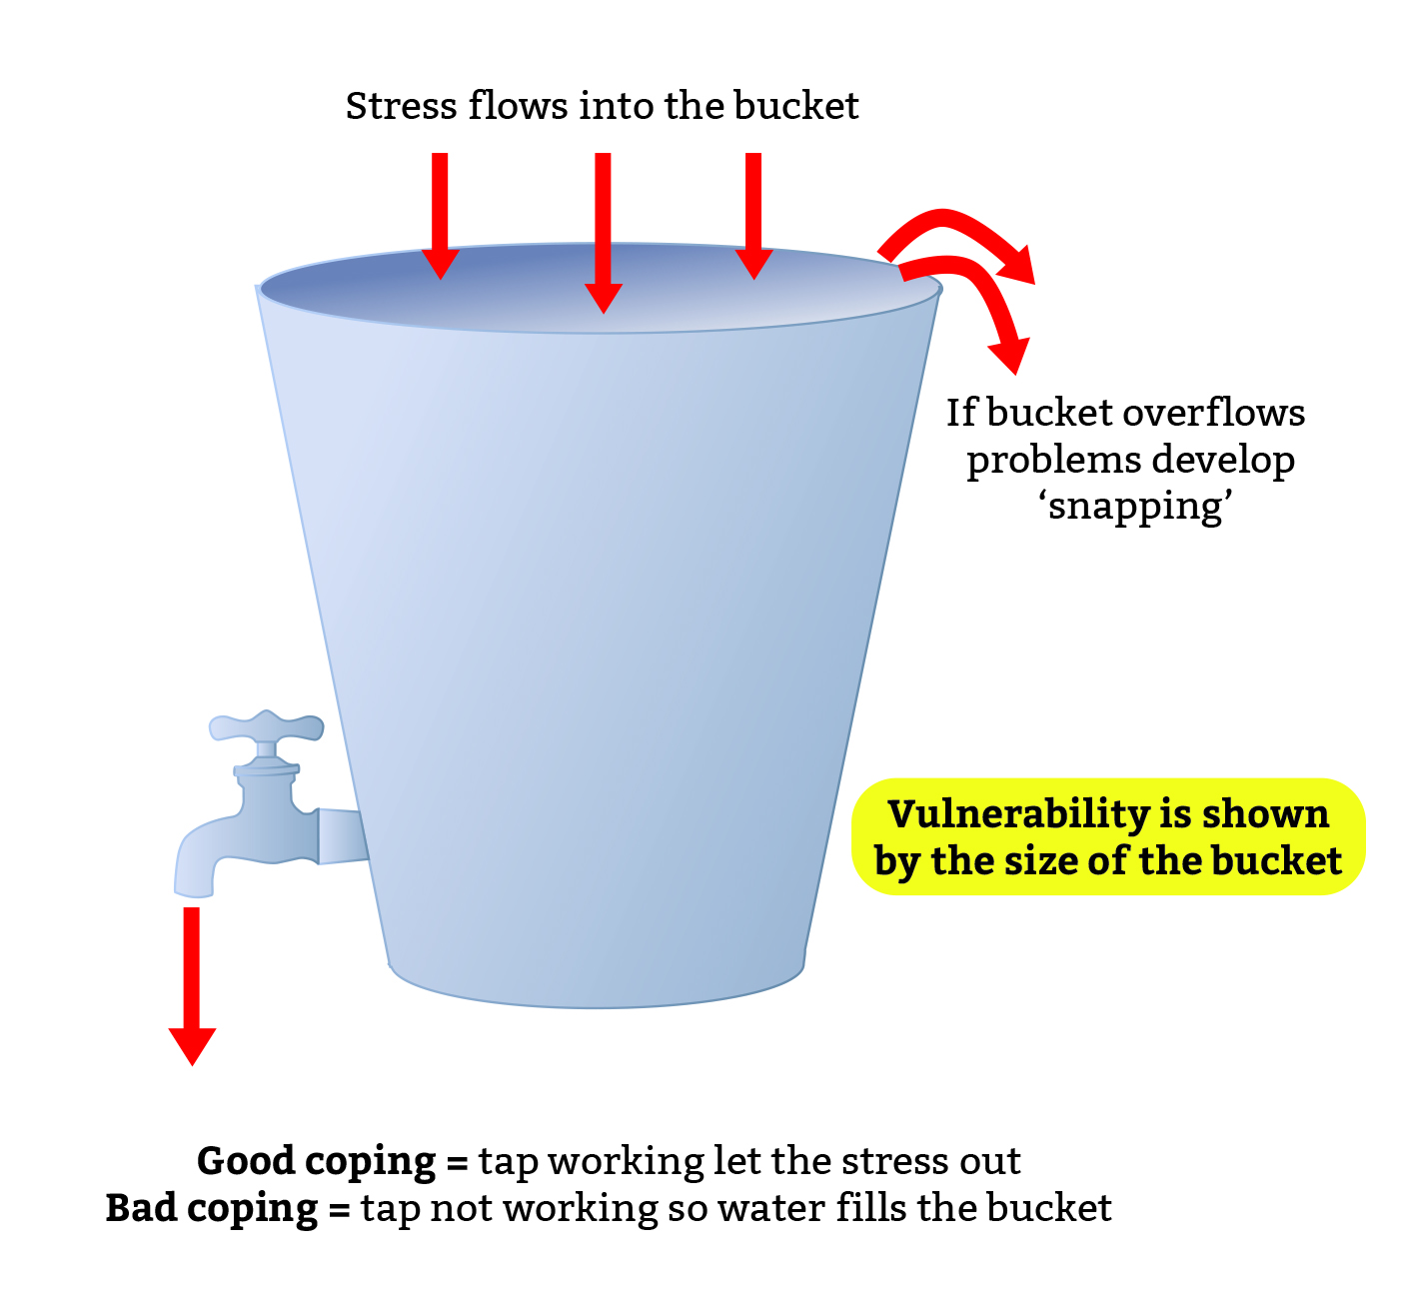
The stress bucket
cfcs.org.uk
Notes:
Kath
Explain the stress bucket and give people a couple of minutes to write down for themselves the things that are in their stress bucket.
Then do a poll (multiple choice)
How full is your bucket?
It’s pretty empty at the moment
It’s manageable – about half full
It’s getting close to the top I’m stressed
It’s overflowing I’m struggling to cope
Then mention the tap and coping strategies – good and (briefly) bad to lead into the next slide.
Also encourage anyone who has put down they are in the bottom two categories to look for support

Slide 12
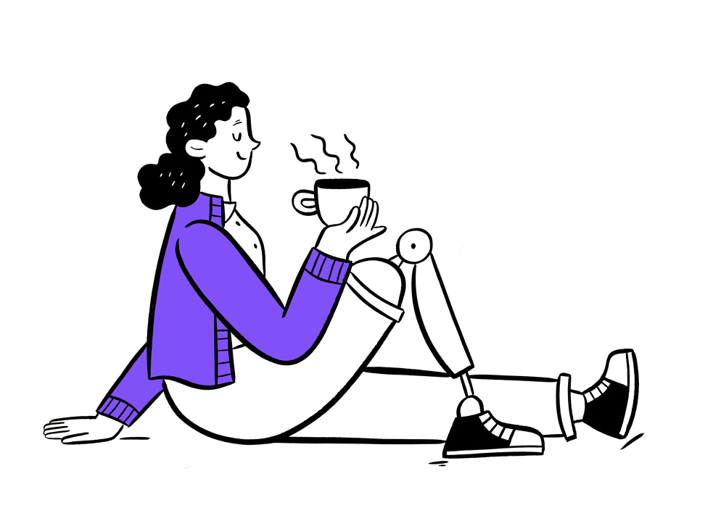
Tips for LOOKING AFTER YOUR WELLBEING
MHF highlighted these evidence ways of improving your mental health for World Mental Health Day
Talk about your feelings
Be mindful of your activity levels
Eat well and drink sensibly
Manage your relationships
Ask for help when you need it
Take a break and get enough sleep
Do something you’re good at
Accept who you are
Care for others
cfcs.org.uk
Notes:
tina
Show just the heading to this slide first and ask for comments in the chat.
If possible have one person sharing the slides and one person reading out things from the chat for this bit.
While waiting for comments to come through could say something like
We hear about mental health all the time nowadays but we may mean different things when we are thinking about it and for some it may still be quite a taboo topic. For example, you might be quite happy talking to others about their mental health, but less comfortable talking about yours!
Move discussion forward through comments in the chat. Depending on participation, may not be able to get to all comments.
Then show the slide and explain that this is not a definition but more a description and perhaps shows how wide this issue is.
I wonder which of these surprise you or speak to you? (Presenters could discuss this for a minute or two)

Slide 13
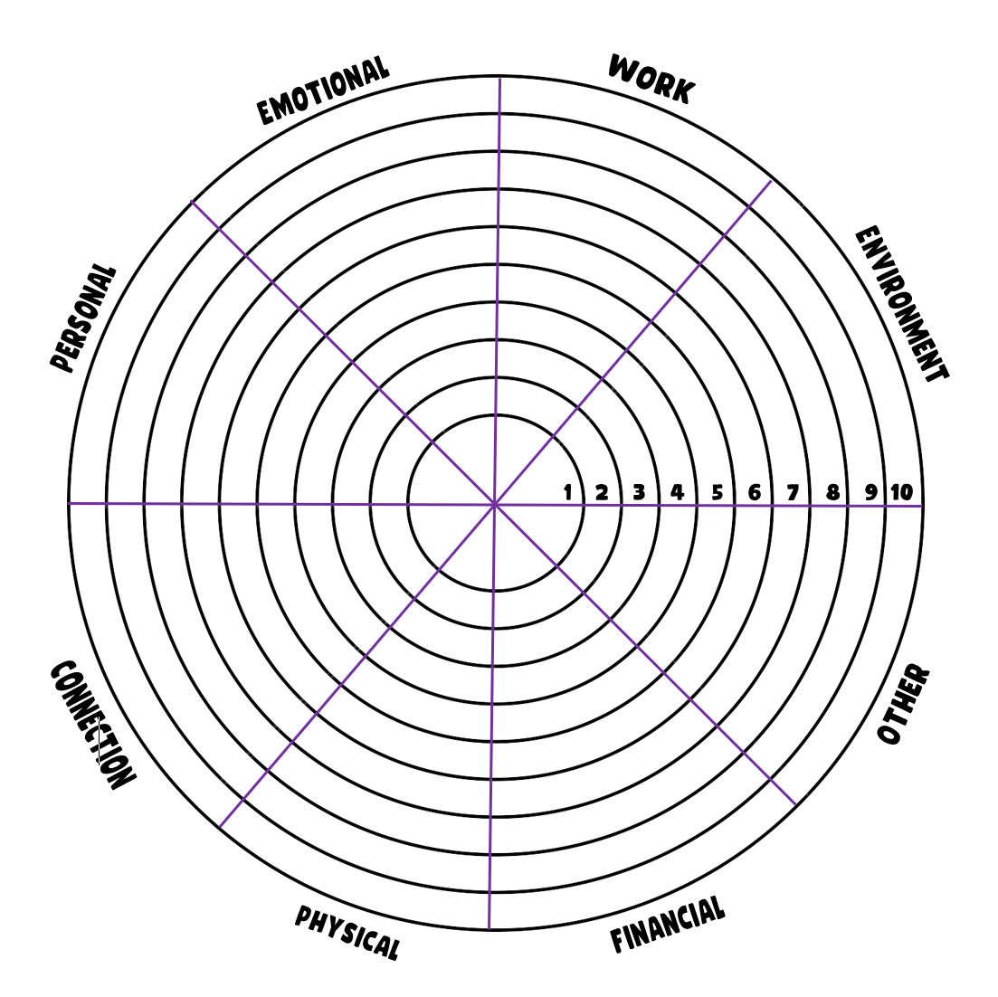
Wellbeing wheel
Focus on eight different aspects of wellbeing
You decide how you are doing
You choose the areas you want to change
You set some SMART goals
cfcs.org.uk
Notes:
Kath
We promised you a tool to help you manage and improve your wellbeing in different areas of your life and here it is. This is actually a prototype so we would really welcome your feedback as we are developing it.
Please put your email address in the chat if you would be willing to give feedback – even if it’s just ‘it was too complicated I just gave up’ or ‘it seemed like a good idea but….’ obviously positive comments will also be helpful!! Put the document in the chat and can send individually to anyone who is willing to give feedback.
Talk through the tool and give examples.
Give information about where they can download it.

Slide 14
And finally a mindful moment ……
cfcs.org.uk
Notes:
Kath
We have mentioned already the benefits of mindfulness – being in the moment. The research suggests that regular mindfulness practice can reduce anxiety and depression, boost immunity, improve sleep, reduce stress, reduce high bloo. pressure and much more. So join in with this as much as you feel comfortable to do so – and this will only last a few minutes.
So you can focus on the lovely picture on the slide, close your eyes if you feel comfortable or just look out of the window.
Make sure you are sitting comfortably with your feet flat on the floor, your back supported by your chair, your hands relaxed and on your lap. Just focus on your breathing
Scan down your body and imagine all the tension being lifted away start with your head……
You will find as you sit here that thoughts will keep coming into your mind. Try to just notice them rather than engaging with them and then letting them go. Try to stay in the moment
Notice what you can hear when you are sitting so quietly – maybe a clock ticking, birds in the garden, passing traffic, the wind in the trees
And now start to focus on your body again if you have had your eyes shut, start to open them, wriggle your fingers and toes, give your shoulders a shake

Slide 15
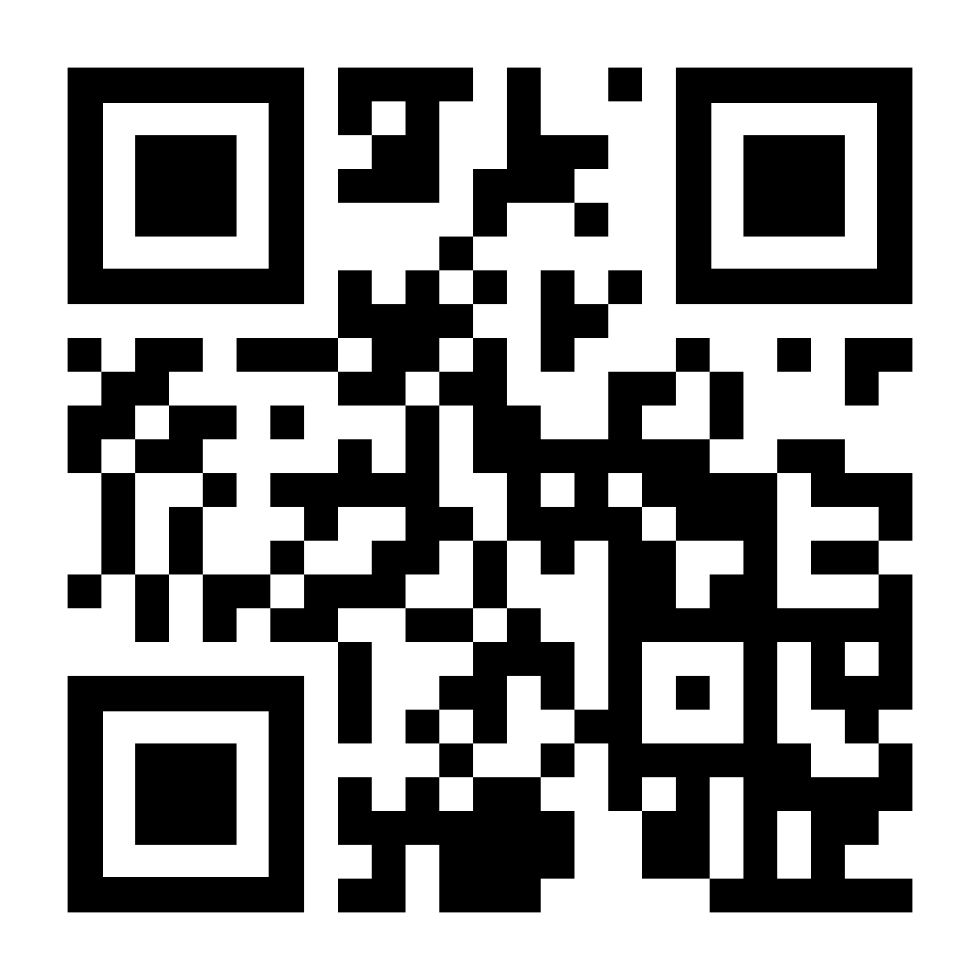
THANK YOU!
Don’t forget to visit us at
CFCS.ORG.UK
Or you can scan this code
to find out more
Notes:
Kath

